Slide 1
High Frequency (Radar)

Slide 2

High Frequency (HF) Radars
Do not be misled by the name
Band | Frequency | Wavelength
Ku | 12-18 GHz | 1.67-2.5 cm
X | 8-12 GHz | 3.7-2.5 cm
C | 4-8 GHz | 3.75-7.5 cm
S | 2-4 GHz | 7.5-15 cm
----- | ----- | -----
Frequency is much, much lower er than Microwave Systems
Wavelength is much, much higher than Microwaves
Compare
EM and sea wave length
Interacts with
sea waves
Interacts with
foam & ripples
HF 3-30 MHz 10-100 m

Slide 3
Longer Wavelength
Lower attenuation > longer range
Unaffected by rain;
Lower resolution
Installations on the coast, bulky and expensive
The signal is transmitted and received through a number of aerials located
on the coast at a height of a few meters, and through different techniques
the azimuth can be pointed to a desired angle.
Various Technologies, but in any case:
Range resolution typically varies between a few hundred meters to 10 km
Azimuthal varies, typical values between 5° and 18°.
(Mantovani et al. 2020). (Rubio et al. 2017).

Slide 4

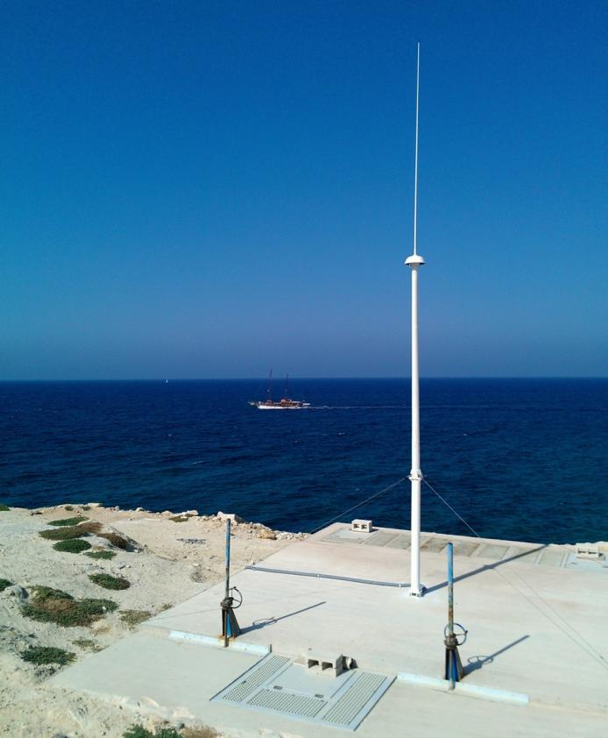





Success of CALYPSO
Operational oceanography in practice
Added value services to a range of users

Slide 5
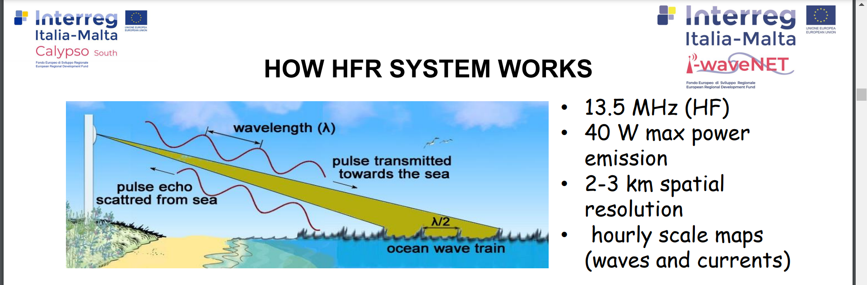
From
Courtesy of Ciraolo et al.
“I radar costieri nell’ottica di una misura integrata del moto ondoso” Autori: Giuseppe Ciraolo, Carlo Lo Re, Giorgio Manno, Fulvio Capodici, Gabriele Nardone, Arianna Orasi
ESPERIENZE DI INGEGNERIA OFFSHORE E MARINA Studi di aggiornamento 2022 20-22 ottobre 2022 - Parma

Slide 6
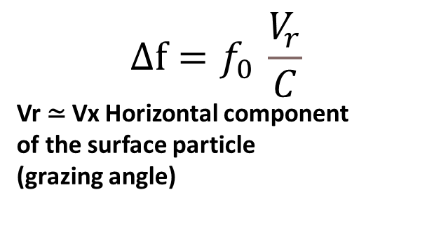
In principle, it is similar to MW Doppler radar
The surface orbital velocity of water particles is exploited to measure the sea state
$$∆f=f_{0 }\frac{V_{r}}{C}$$
Vr ≃ Vx Horizontal component
of the surface particle
(grazing angle)
For a simple monocromatic wave:
Incoming wave , fo is
backscattered with a modified
Frequency fo+-Δf
+ if Vr towards the source
- If Vr away from the source
Horizontal component of water particle velocity (Airy theory, drawing not in scale)

Slide 7

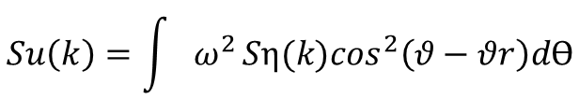
As we know, the water elevation spectrum Sη is related to the velocity spectrum Su
$$Su\left(k\right)=\int{ω^{2}}{Sη(k)cos}^{2}\left(θ−θr\right)dϴ$$
Toporkov and G. S. Brown, "A numerical study of backscattering from time-evolving sea surfaces: comparison of hydrodynamic els," in IEEE Transactions on Geoscience and Remote Sensing, vol. 39 2001, doi: 10.1109/36.964977.
And therefore to the doppler spectrum E($∆f$ )
$∆f=\text{fo}\frac{V_{r}}{C} so Sv(k)\text{\sim }\text{E}(∆f$ )

Slide 8
So, again, if a radar can measure the frequency of the reflected EM waves, it will also measure
the Vr and since Vr ≃ Vx, there is a connection with the wave heights H, and with SWH as well
Besides,
Shadowing plays a smaller role here (higher wavelength), more diffraction around the waves

Slide 9

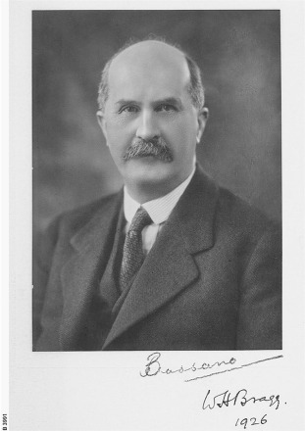
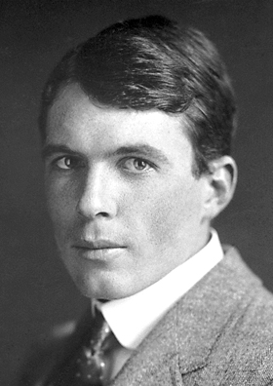
All is well, so?
Unfortunately no.
The situation is much more complex
these two gentlemen will clarify :
William Henry and William Lawrence Bragg
(Father and son)
1862 – 12 March 1942
1890 – 1 July 1971

Slide 10
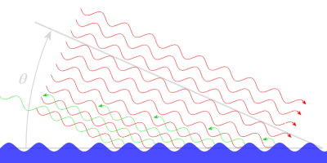
Bragg Effect
They found out that:
“Constructive interference” strongly reinforces the echo
when the incoming wavelength λ is equal to the distance L between reflectors
“reflectors” are the waves
Or, better, areas with the same surface particle speed
signals in the direction of the radar receiver.
Similar effect in MW radar, on a very different scale:
cm rather than metres: enhances bacskscattering
from ripples, so it is beneficial
Lots of other examples in
Physics: e.g.cristallography
https://www.radartutorial.eu/07.waves/wa52.en.html

Slide 11
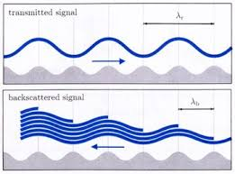
Another example
d =λt/2· cos θ
d = distance of the reflective sub-surfaces
λt = transmitted wavelength
θ = incident angle
Middleditch, A. 2006. Spectral Analysis in High Frequency Radar Oceanography. PhD thesis, University of Sheffield

Slide 12
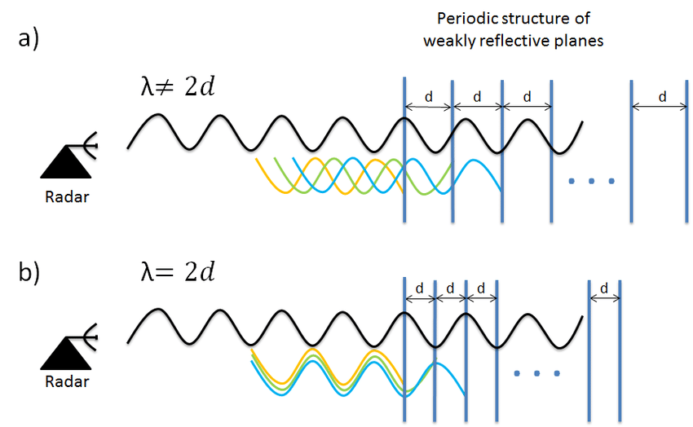
And yet another one

Slide 13
Now, for instance,
At a frequency of 5 MHz, the electromagnetic wave has a wavelength of 60 m; a constructive (Bragg) interference can occur for the 30 m component of the spectrum
And perhaps a few multiples
and submultiples
So, that component will be amplified

Slide 14
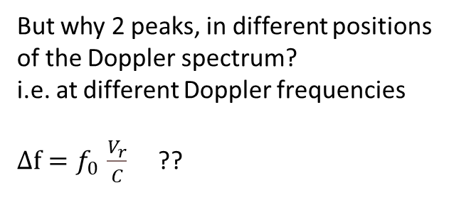
Note asimmetry
Depends on shadowing
(and direction of waves
So, instead of a very polite Doppler
spectrum transformation, like we have
With MW radars
We get a funny thing like this
one
But why 2 peaks, in different positions
of the Doppler spectrum?
i.e. at different Doppler frequencies
$∆f=f_{0 }\frac{V_{r}}{C}$ ??
Typical HF radar Doppler spectrum (from Green and Wyatt, 2006 )

Slide 15


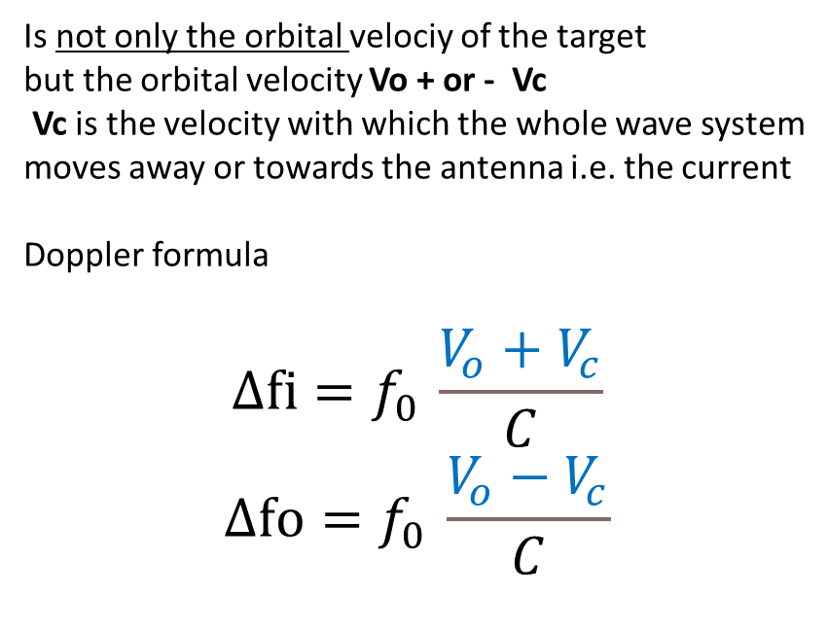
… because the Vr which appears in the
Doppler formula
$$∆f=f_{0 }\frac{V_{r}}{C}$$
Is not only the orbital velociy of the target
but the orbital velocity Vo + or - Vc
Vc is the velocity with which the whole wave system
moves away or towards the antenna i.e. the current
Doppler formula
$$∆fi=f_{0 }\frac{V_{o}+V_{c}}{C}$$
$$∆fo=f_{0 }\frac{V_{o}−V_{c}}{C}$$
So $∆fi$ + $∆fo$
provides a measure of the current!
No wonder!
That is why The HF radar
was introuced in the first place

Slide 16
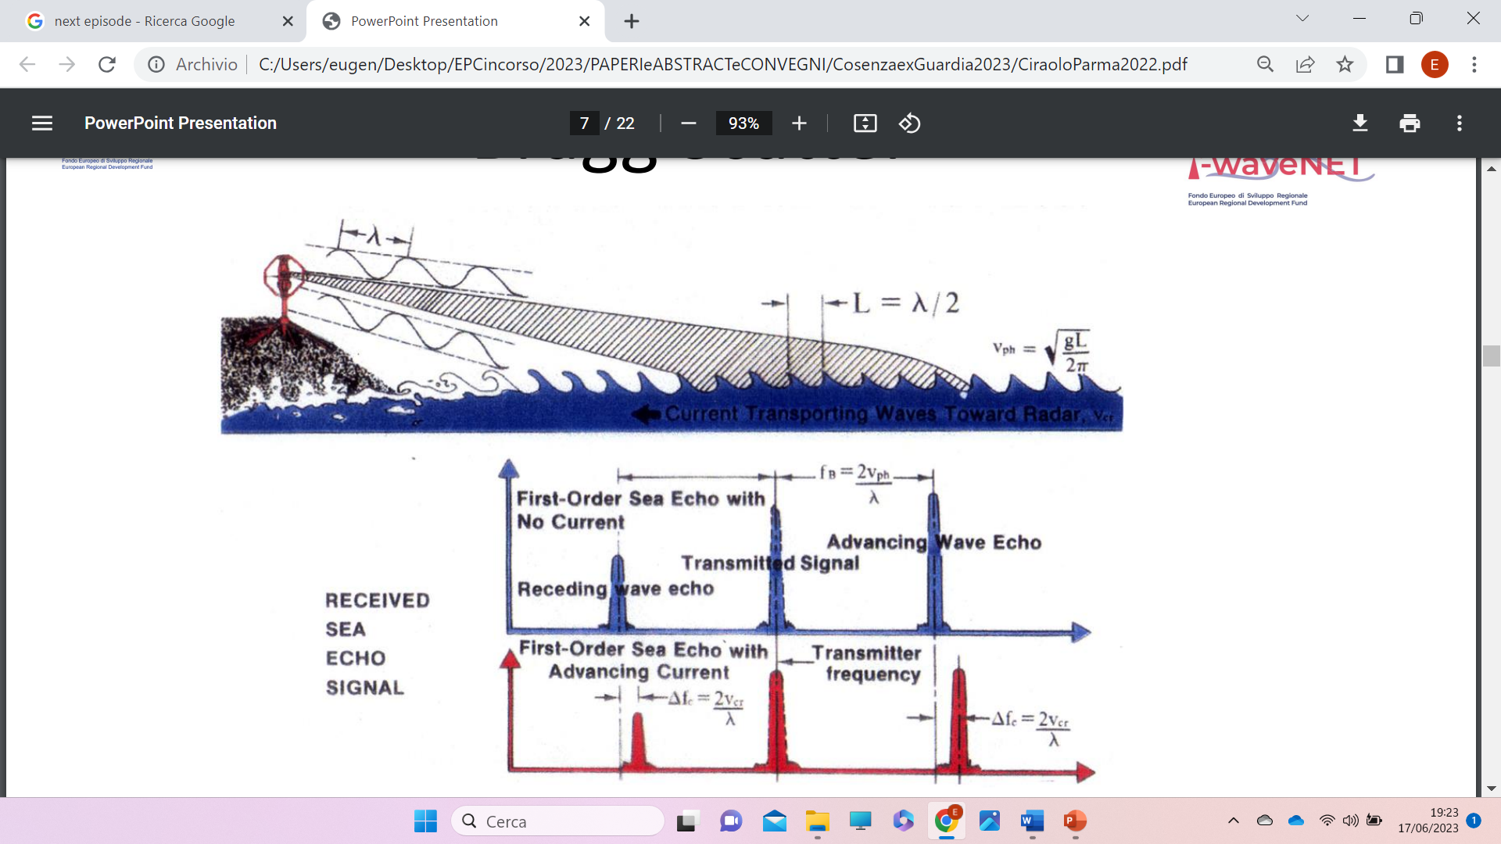
The two main peaks derive from the strengthening of the reflection caused by the Bragg’s Law on the wave velocity spectrum components of length λ; This Bragg induced effect is called “first order spectrum”,
If there is no underlying current velocity Vc the peaks are symmetrical ( not equal);
if on the other hand there is a non-zero Vc , the orbital velocities are increased by ΔΔf = fo Vc/C, so that distance between the two peaks is linked to Vc.

Slide 17
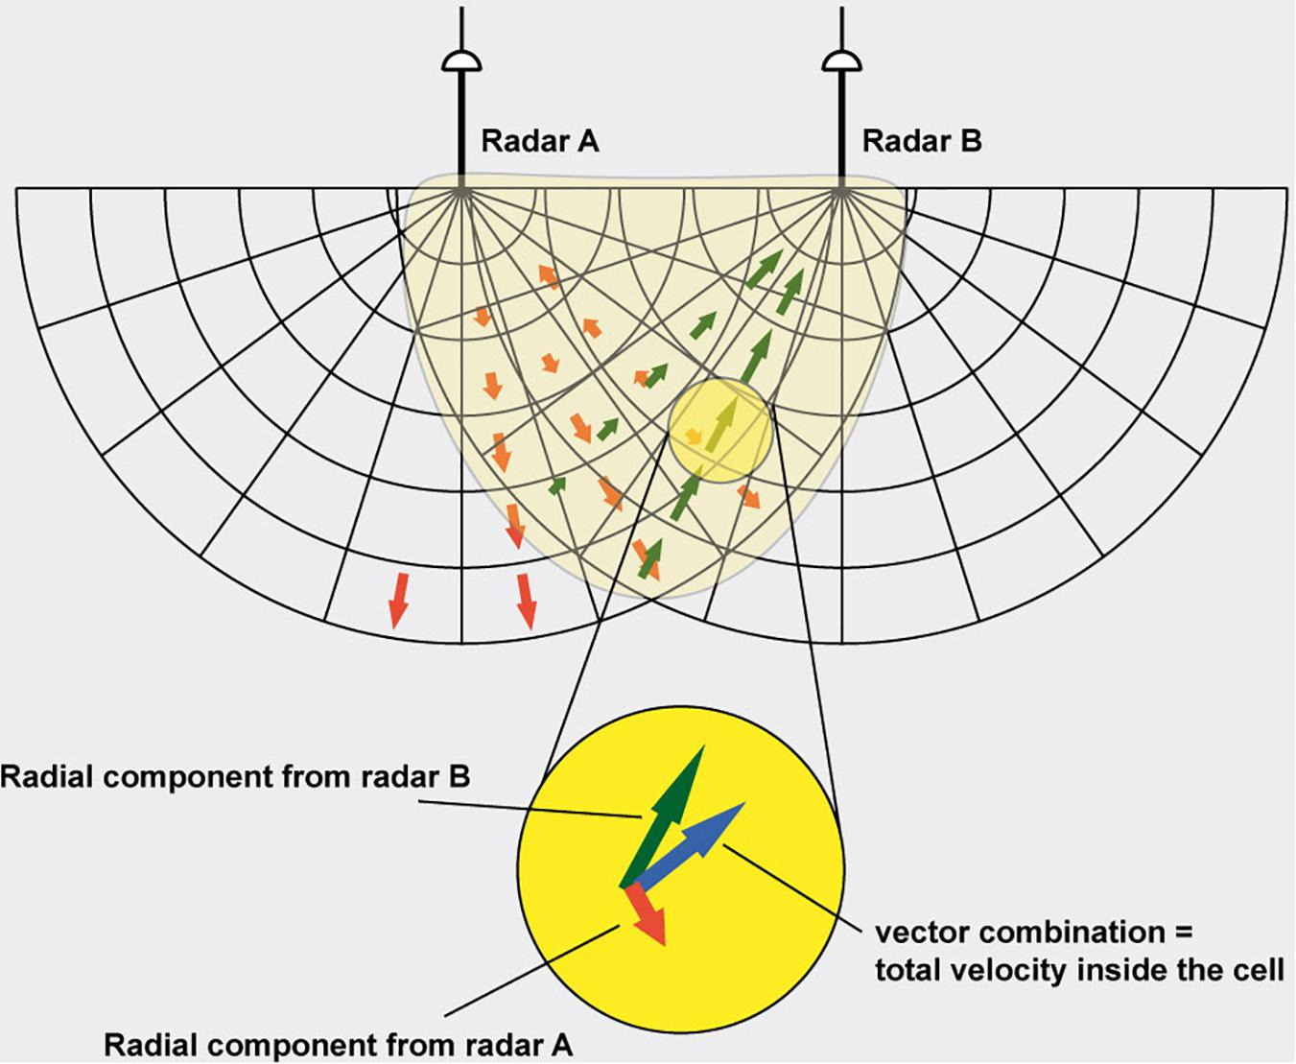
All this of course applies to the velocity components in the direction of the aerial; when measured by at least two independent devices, it provides a sure and effective method for mapping sea currents, which explains the wide diffusion of this system.
Mantovani et al Best Practices on High Frequency Radar Deployment and Operation for Ocean Current Measurement Front. Mar. Sci., 09 April 2020 Sec. Ocean Observation
Volume7 https://www.frontiersin.org/articles/10.3389/fmars.2020.00210/full

Slide 18
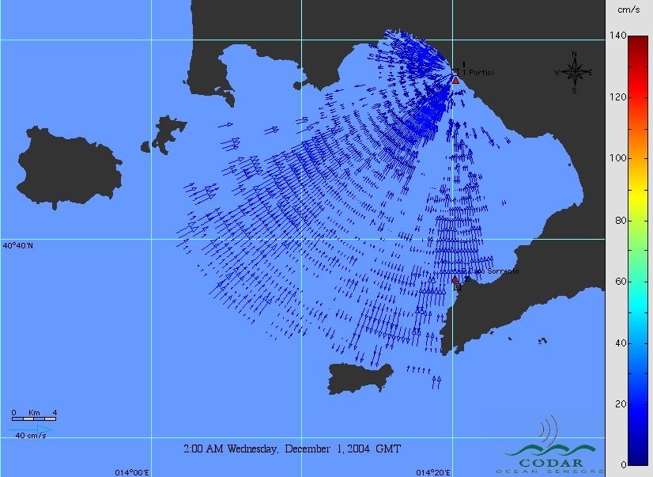
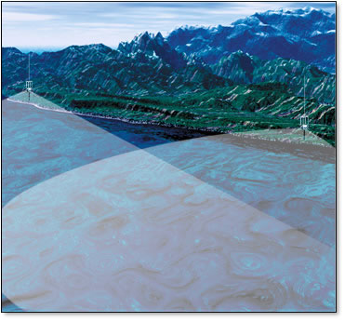
Courtesy E. Zambianchi et al
each station provides radial velocity vectors…
So at least two sites are needed to obtain surface current vectors

Slide 19
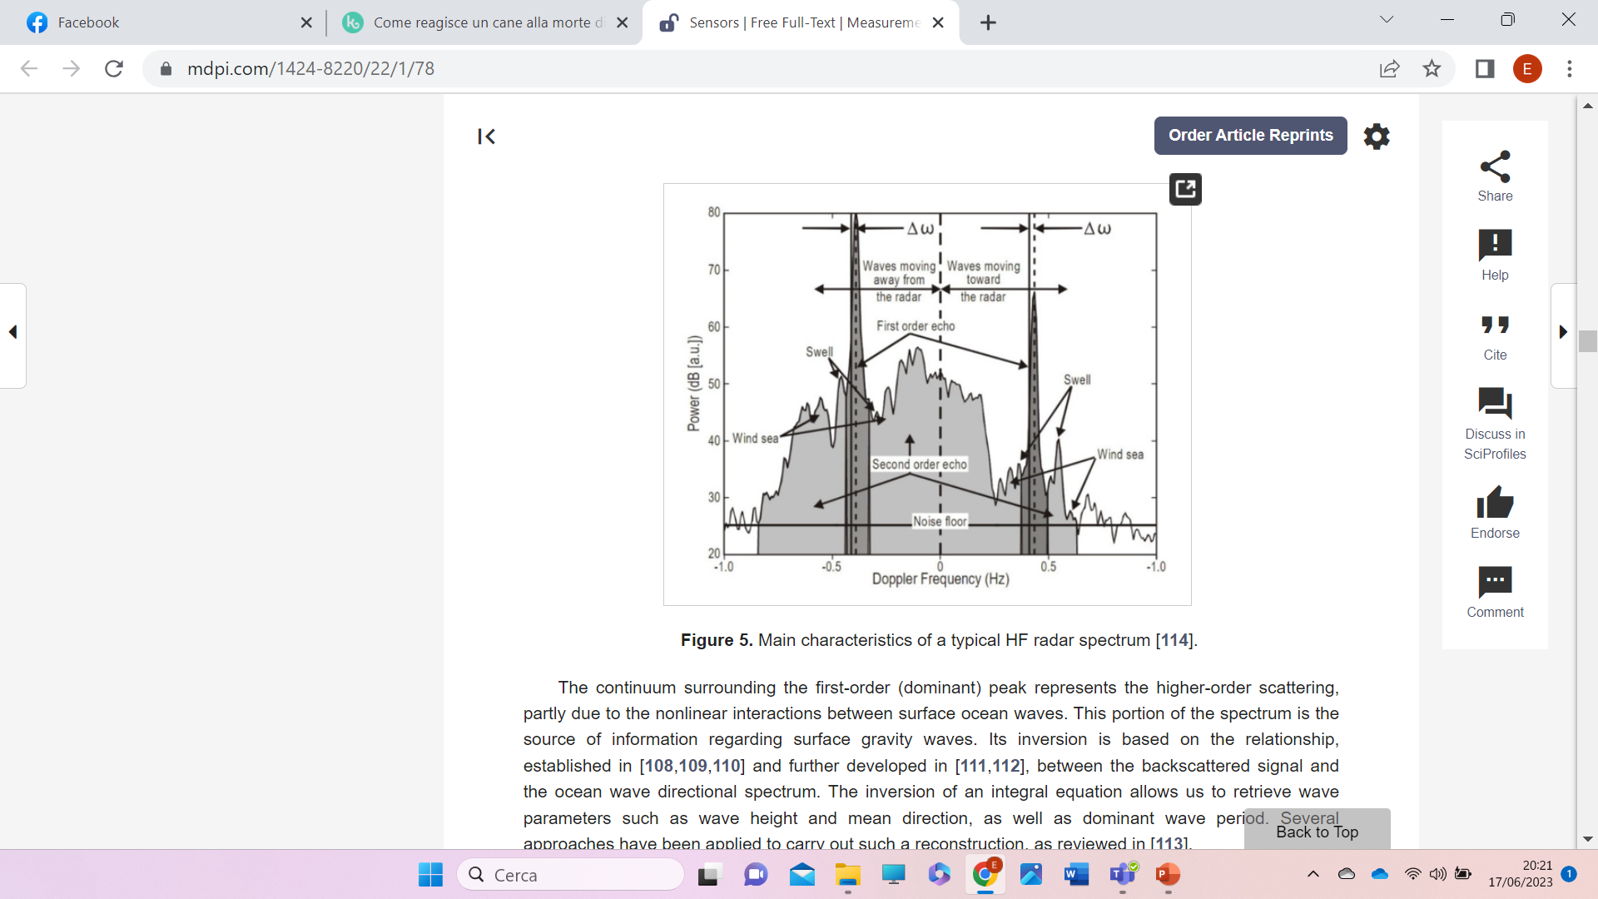
Its application to the measurement of sea state is more complex since it requires the analysis of the part of the spectrum deriving from orbital velocities, i.e. “second order spectrum”.
Toro, V.G.; Ocampo-Torres, F.J.; Osuna, P.; García-Nava, H.; Flores-Vidal, X.; Durazo, R. Analysis of fetch-limited wave growth using high-frequency radars in the Gulf of Tehuantepec. Cienc. Mar. 2014, 40, 113–132.

Slide 20
Reconstructing a wave spectrum from second order Doppler spectra (you need at least 2, as we saw before) is a major task which has been tackled in many ways: see for instance Wyatt’s work (Green and Wyatt 2006) and Saviano et al. 2020.
Theoretical work + a lot of experimental tests has have led to reliable algorithms for the extraction of SWH.
Things however, get even more complicated when the wave spectrum is strongly bidimensional (nearly always)
as in bi-or three modal sea sates
B. Tracy, E. Devaliere, J. Hanson, . Nicolini “Wind Sea and Swell Delineation for Numerical Wave Modeling”)

Slide 21
In Italy, and elsewhere, there are many sites which are currently active and providing useful data,
Among others in the Gulf of Naples and in the Sicilian Channel (see for instance Lorente et al. 2022)

Slide 22
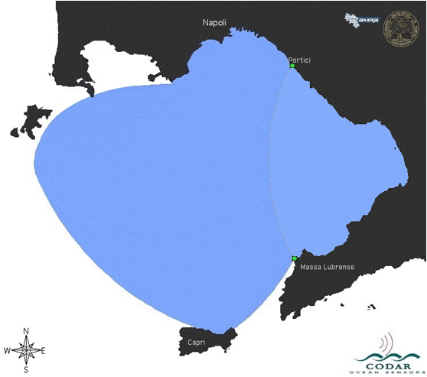
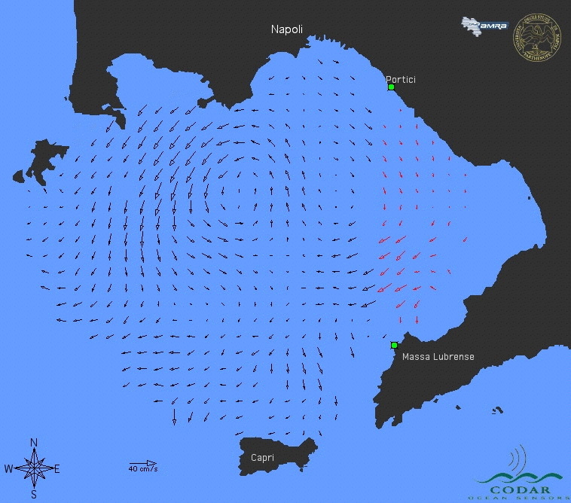
PARTHENOPE COASTAL RADAR spatial res. 1.25 km time res. 1 hr
Courtesy of Zambianchi et al.
sfc currents of
feb 2nd 2005, 18:00 GMT
(in red extrapolated vectors)

Slide 23
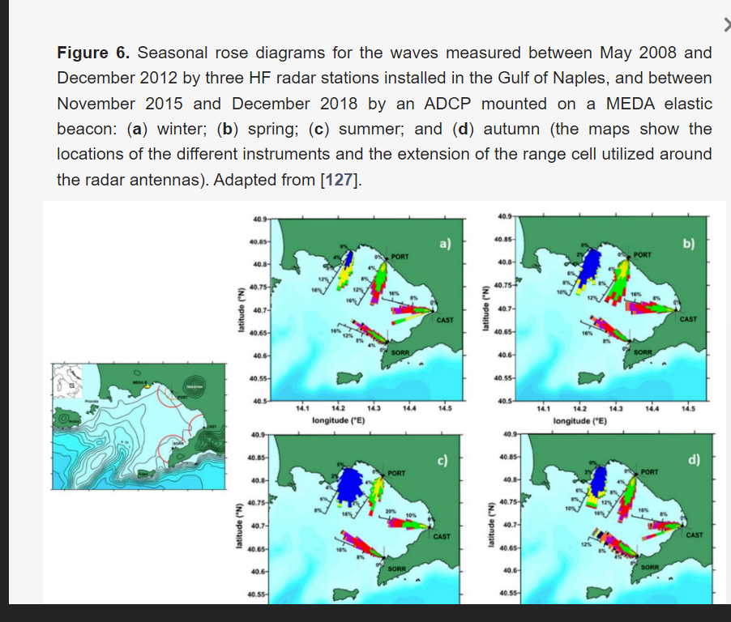

Slide 24

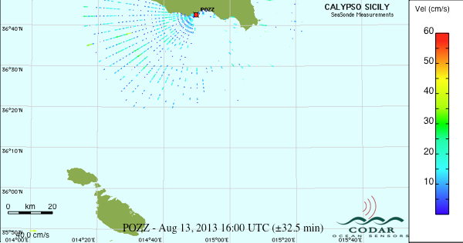
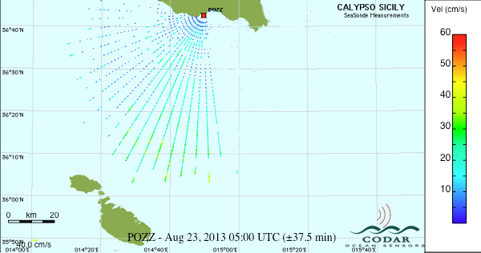
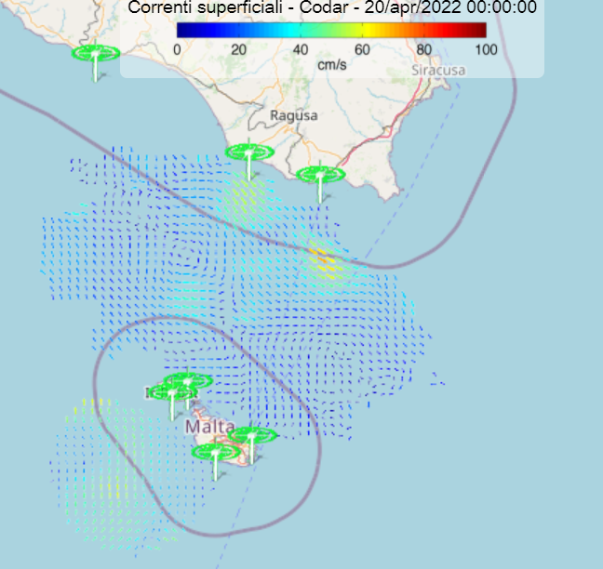
From
Courtesy of Ciraolo et al.

Slide 25
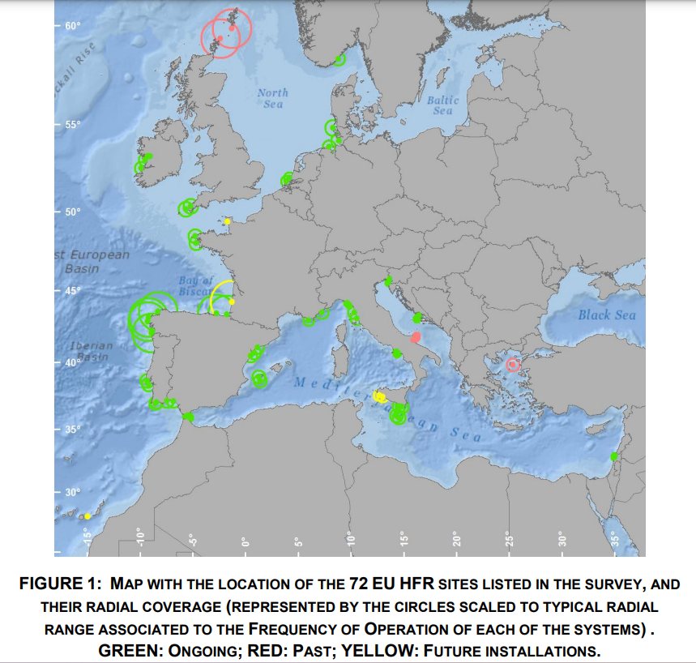
MADER J., RUBIO A., ASENSIO J.L, NOVELLINO A., ALBA M., CORGNATI L., MANTOVANI C., GRIFFA A., GORRINGE P., FERNANDEZ V. (2016) THE EUROPEAN HF RADAR INVENTORY.EUROGOOS PUBLICATIONS.

Slide 26
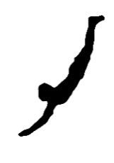
Briefly summarizing about HF wave radar
Good reliability once properly calibrated and tested
Very high range
Undisturbed by rain/hail
Useful integrated with current measurement
But
Very expensive to install and o run
Need furthere development to deal with complex sea states

Slide 27
CONCLUSIONS:
Microwave (centimetric) land and platform based radar systems (grazing angle) are well developed and provide reliable measurement in many cases. Progress have still needed however to improve their reliability in heavy rain (possibly switching to higher wavelength), and to remove the necessity of calibration (adoption of Doppler based systems).
Altimeter short wave radar measurement of the sea state from satellite (Low incidence) is “the Gold Standard” ( Rossi et al 2022) of offshore wave measurement. Altimeter satellite provide most of the information needed by large scale wave models for both forecast and analyses. Altimeters however do not provide information on either the spectral distribution or the direction; progress in this direction might possibly come from application and improvement of SAR techniques and from more advanced instrumentation being currently tested (SWIM)
Integration of all the available sensor should provide the final answer to the monitoring of sea state data for most application.

Slide 28
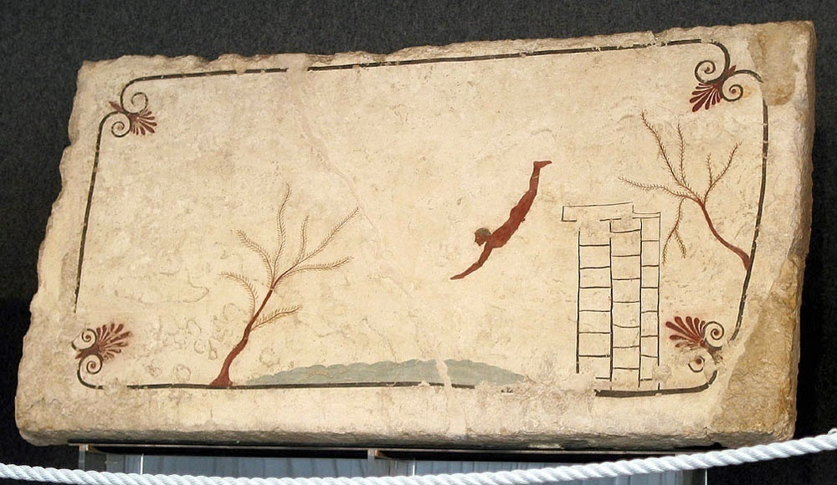
ACKNOWLEDGEMENTS
We are grateful for help, data, advice and useful discussion over many years to:
APAT/ISPRA (So many of them: e.g. S. Morucci, A. Orasi, G. Nardone, Inghilesi)
Italian Air Force Meteo Office (R. Tajani, C. De Simone, L. Torrisi)
ESA/ESRIN (J. Benveniste, P. Cipollini)
KISR (K. Rakha, K. Al Baana)
IREA/REMOCEAN (F.Serafino)
UNISA and CUGRI: G. Spulsi, F. Reale
.UNIPA G. Ciraolo
Altimeter data from
Radar Altimeter Database System (RADS) http://rads.tudelft.nl/rads/rads.shtml
ESA/EO Project 1172 “Remote Sensing of Wave Transformation”
Hurricane Applications Project,E-Surge
The diver’s tumb
Paestum (Campania, Italy)
(ca. 480-470 BC)

Slide 29
Maa J. P.-Y. and Ha H.K. (2005). X-band radar wave observation system Field Testing of a Physical/Biological Monitoring Methodology for Offshore Dredging and and Mining Operations. vol. 56. Washington, DC, USA: U.S. Department of the Interior, Minerals Management Service, 2005.
Mantovani C., Corgnati L., Horstmann J., Rubio A., Reyes E., Quentin C., Cosoli S., JAsensio. L., Mader J. and Griffa A. (2020). Best Practices on High Frequency Radar Deployment and Operation for Ocean Current Measurement. Frontiers Marine Science, vol. 7, pp. 210.
Orasi A., Picone M., Drago A., Capodici F., Gauci A., Nardone G, Inghilesi R., Azzopardi J., Galea A., Ciraolo G., Musulin J.S., Alonso-Martirena A. (2019). HF radar for wind waves measurements in the Malta-Sicily Channel. Remote Sensing, 11.
Plant W.J., Keller W.C. (1990). Evidence of Bragg scattering in microwave Doppler spectra of sea return. Journal of Geophysical Research: Oceans, 95, 16299–16310.
Roarty H., Cook T., Hazard L., George D. (2019). The Global High Frequency Radar Network. Frontiers Marine Science, vol. 6, pp. 164.
Rossi G.B., Cannata A., Iengo A., Migliaccio M., Nardone G., Piscopo V., Zambianchi E. (2022). Measurement of Sea Waves. Sensors, 22, 78. https://doi.org/10.3390/s22010078.
Rubio A., Mader J., Corgnati L., Mantovani C., Griffa A., Novellino A., Quentin C., Wyatt L., Schulz-Stellenfleth J., Horstmann J., et al. (2017). HF radar activity in European coastal seas: Next steps toward a pan-European HF radar network. . Frontiers Marine Science, 4, 8.
Saviano S., De Leo F., Besio G., Zambianchi E., Uttieri M. (2020). HF Radar Measurements of Surface Waves in the Gulf of Naples Tyrrhenian Sea): Comparison With Hindcast Results at Different Scales. Frontiers Marine Science, Sec. Ocean Observation, vol 7.
Vignudelli S., Kostianov A.G., Cipollini P, Benveniste J. (2011). In book Coastal Altimetry - Springer-Verlag Berlin Heidelberg.
Wenzel L.B. (1990). Electromagnetic scattering from the sea at low grazing angles. In Suface Waves and Fluxes, Geernaert, G.L., Plant, W.J., Eds., Kluwer Academic: Norwell, MA, USA, 1990; pp.41–108.
References
Chelton D.B., Ries J.C., Haines B.J., Fu L.-L., Callahan P.S. (2001). Satellite altimetry – Chapter 1 in Satellite Altimetry and Earth Sciences Handbook of Techniques and Applications - Academic Press, San Diego, California, USA.
Chen Z., Wang Z., Chen X., Zhao C., Xie F., He C. (2017). S-Band Doppler Wave Radar System. Remote Sensing 9, 1302.
Chen Z., Chen X., Zhao C., Wang Z. (2019). Wave Height and Wave Period Derived from a Shipboard Coherent S-Band Wave Radar in the South China Sea. Remote Sensing, 11, 2812.
Cui J., Bachmayer R., de Young B., Huang W. (2019). Experimental Investigation of Ocean Wave Measurement Using Short-Range K-Band Radar: Dock-Based and Boat-Based Wind Wave Measurements. Remote Sensing, vol. 11, no. 13, pp. 1607.
Green J. Jim and Lucy R. Wyatt. (2006). Row-Action Inversion of the Barrick–Weber Equations. Journal of Atmospheric and Oceanic Technology, 23, 501-510.
Hao-Yuan C., and Chien H. (2017). Implementation of S-band marine radar for surface wave measurement under precipitation. Remote Sensing of Environment, 188 (2017): 85-94.
Hauser, D., et al (eds) (2005). Measuring and analysing the directional spectra of ocean waves. Luxembourg, Office for Official Publications of the European Communities, 485pp. DOI: http://dx.doi.org/10.25607/OBP-811.
Horstmann J., Bödewadt J., Carrasco R., Cysewski M., Seemann J., Streβer, M. (2021). A coherent on receive x-band marine radar for ocean observations. Sensors, 21(23) doi:10.3390/s21237828.
Huang W., Carrasco R., Shen C., Gill E. W., Horstmann J. 2016. Surface Current Measurements Using X-Band Marine Radar With Vertical Polarization," in IEEE Transactions on Geoscience and Remote Sensing, vol. 54, no. 5, pp. 2988-2997, (May 2016), doi: 10.1109/TGRS.2015.2509781.
Lee P.H.Y., Barter J.D., Beach K.L., Hindman C.L., Lade B.M., Rungaldier H., Shelton J.C., Williams A.B., Yee R., Yuen H.C. (1995). X-Band Microwave Backscattering from Ocean Waves. Journal of Geophysical Research. 100, 2591–2611.

Slide 30
Lorente P., Aguiar E., Bendoni M., Berta M., Brandini C., Caceres-Euse A., Capodici F., Cianelli D., Ciraolo G., Corgnati L., Dadic V., Doronzo B., Drago A., Dumas D., Falco P., Fattorini M., Gauci A., Gomez R., Griffa A., Guerin C.,-A., Hernandez-Carrasco I., Hernandez-Lasheras J., Liver M., Magaldi M., G., Mantovani C., Mihanovi'c H., Molcard A., Mourre B., Orfila A., Revelard A., Reyes E., S'anchez J., Saviano S., Sciascia R., Taddei S., Tintore J., Toledo Y., Ursella L., Uttieri M., Vilibic I., Zambianchi E., Cardin V. (2022). Coastal high-frequency radars in the Mediterranean -- Part 1: Status of operations and a framework for future development. Ocean Science, Vol 18.
Ludeno G., Reale F., Dentale F., Pugliese Carratelli E., Natale A., Serafino F. (2015a). Estimating Nearshore Bathymetry from X-Band Radar Data. Coastal Ocean Observing Systems. Pages 265 – 280, June 23.
Ludeno G., Reale F., Dentale F., Carratelli E.P., Natale A., Soldovieri F., Serafino F. (2015b). An X-band radar system for bathymetry and wave field analysis in a harbour area. Sensor. 15, 1691–1707.
Ludeno G., Catapano I., Soldovieri F., Gennarelli G. (2023). Retrieval of Sea Surface Currents and Directional Wave Spectra by 24 GHz FMCW MIMO Radar. In IEEE Transactions on Geoscience and Remote Sensing, vol. 61, pp. 1-13. doi: 10.1109/TGRS.2023.3236359.
Maa J. P.-Y. and Ha H.K. (2005). X-band radar wave observation system Field Testing of a Physical/Biological Monitoring Methodology for Offshore Dredging and and Mining Operations. vol. 56. Washington, DC, USA: U.S. Department of the Interior, Minerals Management Service, 2005.
Mantovani C., Corgnati L., Horstmann J., Rubio A., Reyes E., Quentin C., Cosoli S., JAsensio. L., Mader J. and Griffa A. (2020). Best Practices on High Frequency Radar Deployment and Operation for Ocean Current Measurement. Frontiers Marine Science, vol. 7, pp. 210.
Orasi A., Picone M., Drago A., Capodici F., Gauci A., Nardone G, Inghilesi R., Azzopardi J., Galea A., Ciraolo G., Musulin J.S., Alonso-Martirena A. (2019). HF radar for wind waves measurements in the Malta-Sicily Channel. Remote Sensing, 11.
Plant W.J., Keller W.C. (1990). Evidence of Bragg scattering in microwave Doppler spectra of sea return. Journal of Geophysical Research: Oceans, 95, 16299–16310.
Roarty H., Cook T., Hazard L., George D. (2019). The Global High Frequency Radar Network. Frontiers Marine Science, vol. 6, pp. 164.
Rossi G.B., Cannata A., Iengo A., Migliaccio M., Nardone G., Piscopo V., Zambianchi E. (2022). Measurement of Sea Waves. Sensors, 22, 78. https://doi.org/10.3390/s22010078

Slide 31
Rubio A., Mader J., Corgnati L., Mantovani C., Griffa A., Novellino A., Quentin C., Wyatt L., Schulz-Stellenfleth J., Horstmann J., et al. (2017). HF radar activity in European coastal seas: Next steps toward a pan-European HF radar network. . Frontiers Marine Science, 4, 8.
Saviano S., De Leo F., Besio G., Zambianchi E., Uttieri M. (2020). HF Radar Measurements of Surface Waves in the Gulf of Naples Tyrrhenian Sea): Comparison With Hindcast Results at Different Scales. Frontiers Marine Science, Sec. Ocean Observation, vol 7.
Vignudelli S., Kostianov A.G., Cipollini P, Benveniste J. (2011). In book Coastal Altimetry - Springer-Verlag Berlin Heidelberg.
Wenzel L.B. (1990). Electromagnetic scattering from the sea at low grazing angles. In Suface Waves and Fluxes, Geernaert, G.L., Plant, W.J., Eds., Kluwer Academic: Norwell, MA, USA, 1990; pp.41–108.

