Slide 1
Microwave Systems
High incidence angle:
Satellite altimetry

Slide 2
The principle is similar: ,
BUT: The incidence angle is high, hence
If specular (and no wind) : pure reflection
If rough (wind, foam): scattering, the reflection is much less
Scattered in various
direction, therefore
Ϭl smaller
Nearly specular, so
Ϭl bigger
σo
Depends or mainly (not only) on
Roughness
And therefore
on Wind
Well,
Tilt has a minor
Role in altimeters
Important in SAS
Braggs doesn’t help

Slide 3
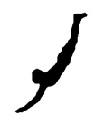
Well, resolution can be improved
with a clever trick: SAR
No imaging * Resolution is too low (distance!)
Φ exagerated
Tilt Φ
Again, if the resolution is small enough, we see :
Local (“at least a few Pixels”)
variations of σl -
connected to the sea state, i.e. wave agitation…
Modulation
no image: radiometer. Wind
SWIM/CFOSAT: wind, waves
Image: SAR
Spectral Data,direction…wind
no image: altimeter. Nearly vertical SWH, wind
If we see an average on “many pixels” σl
Average backscattering coefficient σo
No modulation: average Ϭo

Slide 4
A brief digression, just to clarify dependence of σo
on incidence, wind direction and speed
(scatterometer, NOT altimeter)
Incidence 23°, not 0)
Not today!
σo (backscattering, radar section) depends on the
wind (a lot)
Incidence angle
low but not vertical

Slide 5

Coming back to altimeters
A good reference is Chelton et al..
So: how does a satellite altimeter work?
Altimeter satellites fly on a relatively
low orbit:
Typical parameters
Height: 900km
Speed: 7 km/s
1 orbit about 1 h
Antenna opening: 0.3°
Frequencies: C, X, K
Reale et al, 2014 Remote Semsing
A 1 s«sample» is the result
of a complex average
Up to 1000
10Hz, 20 Hz data available
1 sample x second
Ground resolution: 7km
about 5-6
Varies
(see in the following)
7km
Incidence 0 => no information on wind direction

Slide 6
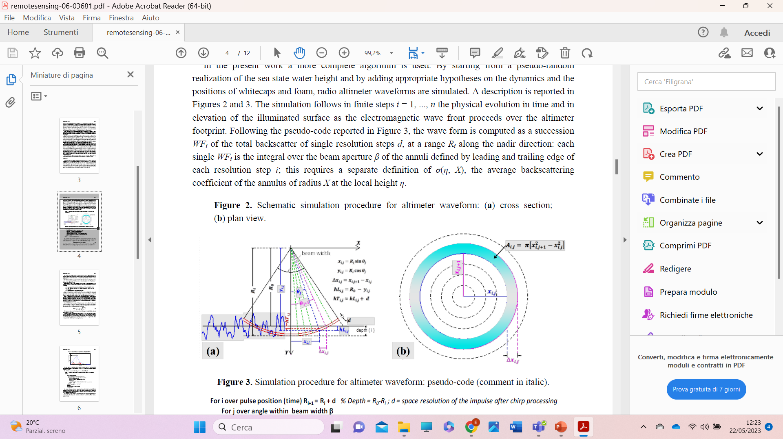
How do we manage to measure SWH?
By analysing the ime response
The altimeter antenna sends to the sea surface an electromagnetic impulse of very short duration: (typical effective pulse duration after pulse compression) is about 3 n·s
the reflected signal (waveform) after preliminary processing to correct errors of electromagnetic origin, is analyzed to extract the required parameters.
Time delay rings
Reale et al.

Slide 7
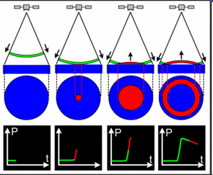
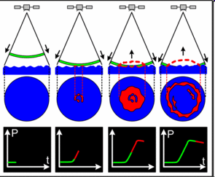
A look at the waveform
(Time response)
Smooth surface
Rough surface
The area covered
By the wave front
increases with time
From ESA handbooks
waveforms

Slide 8
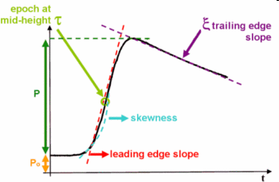
So, if we plot the received signal as a function of time
we get something like this: Waveform
Epoch (time) τ at mid height is linked
to sea level We may not care
Very much, but…
Total reflected energy (segment P), integrated over the whole Ϭo i.e the NRCS (Normalized Radar Cross Section) it provides an estimate of the
wind velocity, since both wind induced ripples and sea foam decrease the local surface reflectivity.
Slope is directly connected
To SWH
Calibration of the link between Ϭ0 and wind speed has been carried out by many researchers over many years

Slide 9
Envisat RA-2,
Occasionally.
1800-Hz (along-track 3.70 m).
Can produce data at 18 Hz (nominal along track 370 m),
but form most engineering, ocenographical or metereological
purposes, 1 Hz is enough
«Gates»

Slide 10
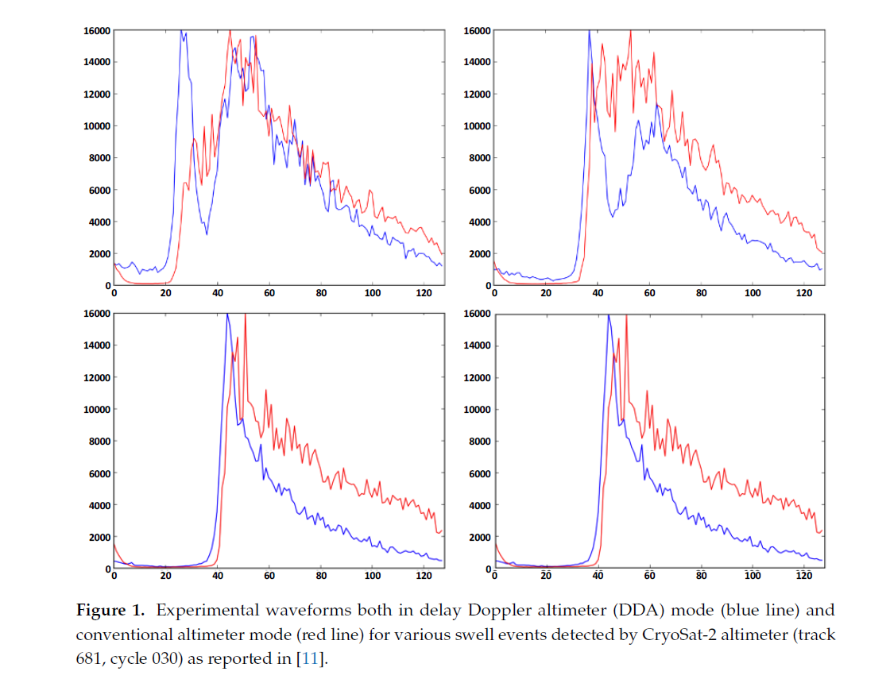
Real life can be tricky.
That’s why we average many
waveforms
Reale, F., Carratelli, E.P., Di Leo, A., Dentale, F. Wave orbital velocity effects on radar Doppler altimeter for sea monitoring (2020) Journal of Marine Science and Engineering, 8

Slide 11
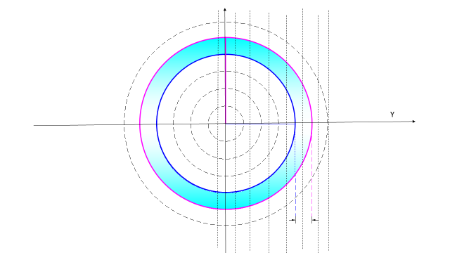
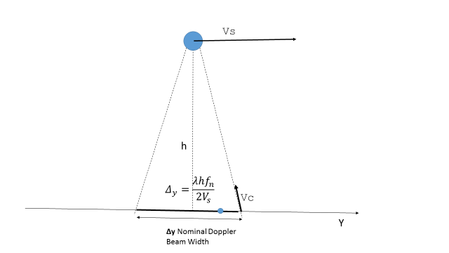
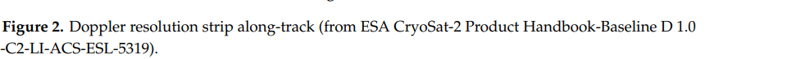
A further refinment
Doppler altimeter. A clever trick
Distance rings
Velocity/distance
Strips (380 m)
But do we really need
a resolution (azimuth)
of a few hundred metres?

Slide 12
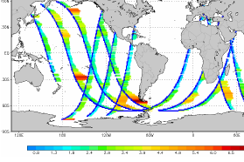
25.24675 |  | 2805.195 |  | 1558.442
interval in degr |  | int in km |  | int miglia
 |  | equatore
So, what do these satellite altimeters do for us ?
Altimeter satellites fly around the earth at a height of about 900 km, a ground speed of 7 km/h. The orbits last about 1.5 h
So, while the resolution, as described before is of the order of a few km²
the actual availability of data is limited
1 sample x second
Ground resolution: 7km
Measurement collected in a 6h period
By two satellites (ENVISAT, Jason)

Slide 13
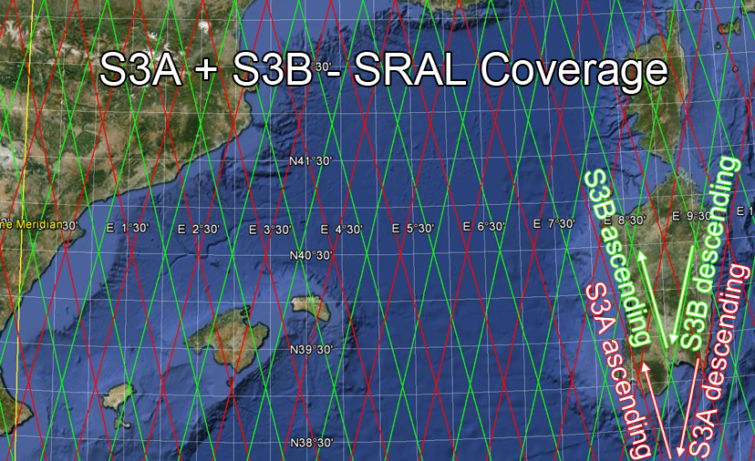
Height 835 orbit inclination 98.65 °
For instance
Sentinel-3 (A and B)
Repeat cycle is the time taken for the satellite to go over the same geographical point on the ground.
Cycle is 27 days (14+7/27 orbits per day=14.26 , 385 orbits per cycle)
Time between passages at the equator (at any latitude) 24/14.25 = 1.683 h
Daily intervals (degrees) between passages at the equator (at any latitude) = 360/14.25 = 25.25°
Daily intervals (km) at the equator 40000/14.25=2800km;
Every day shifts = 2080 km (at the equator)
If it were an integer,
It would go over the same
place every day
Interval (degrees) in a cycle (27 days)=360/385=0.93°
Interval km in a cycle at the equator = 40000/385=103km
Interval km in a cycle at lat 38°= 40000/385=81km
,
CryoSat’s slightly different
has a 369 day repeat cycle (with a 30 day sub-cycle).

Slide 14
See for instance
J.Aublanc& & P.ThibautP.Thibaut(CLS)(CLS)
M.McMillan(Lancaster University) (Lancaster University)
E.Rinne 2020 ESA
Influence of shift
Shift
A passage over the same spot every cycle
and a number of passages over the same genral
area (e.g. over 500 km about 10 passes)
Or we could have a passage every day (for instance)
over the same spot, but no information on the
area between two orbits

Slide 15
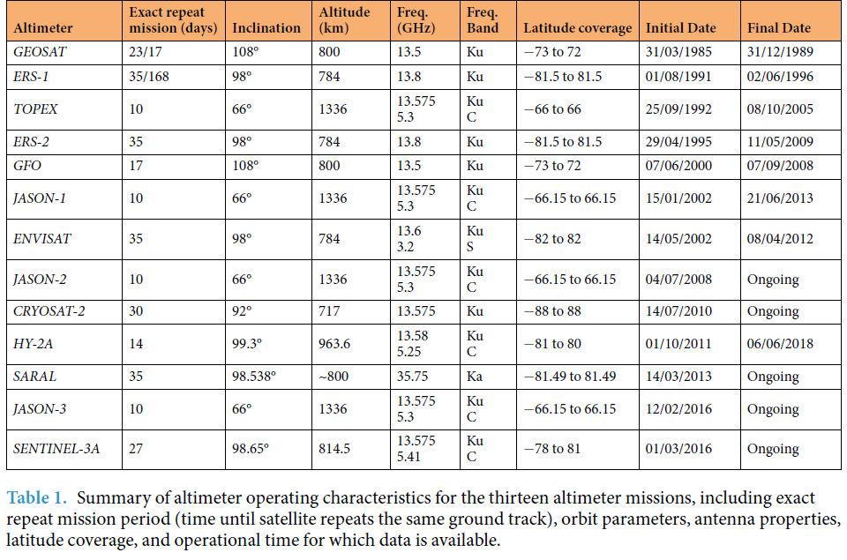
Who is flying at a given moment :
where can we get the data
This was the situation in 2019
Ribald and Young nature 2019
http://rads.tudelft.nl/rads/rads.shtml
https://sentinels.copernicus.eu/documents/247904/351187/S3_SP-1322_3.pdf

Slide 16
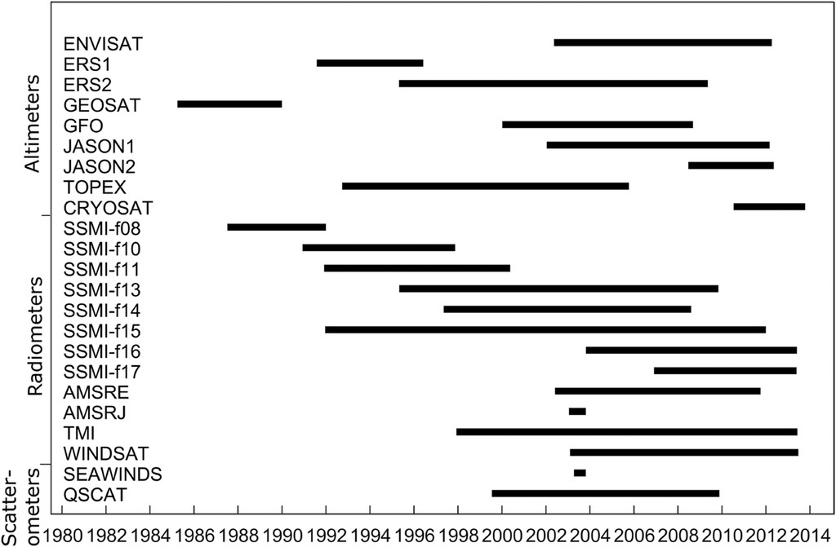
And who flew in the past:

Slide 17
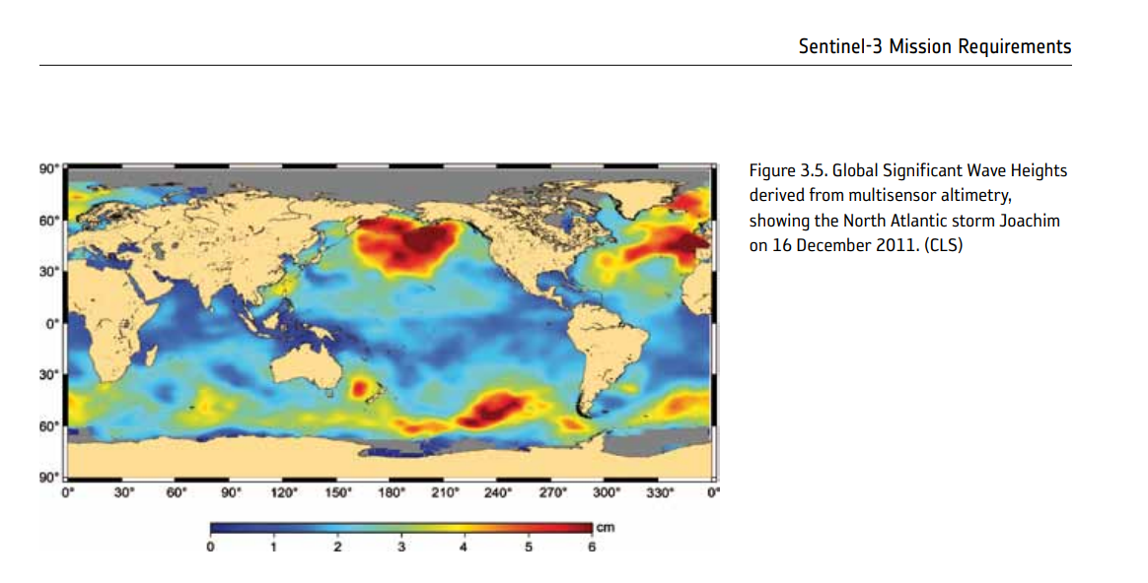
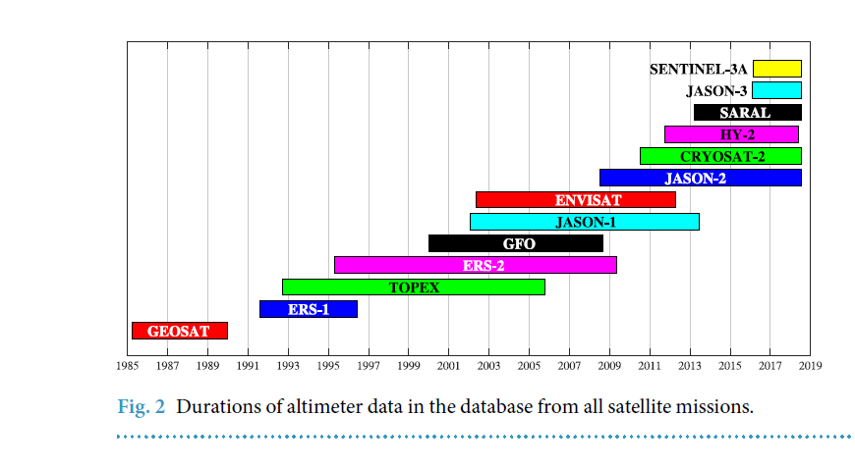
Data can be merged to obtain global
Statistics
Ribal, AgustinusAU - Young, Ian R.PY - 2019DA - 2019/05/29TI -
33 years of globally calibrated wave height and wind speed data based on altimeter observationsJO - Scientific DataSP - 77

Slide 18
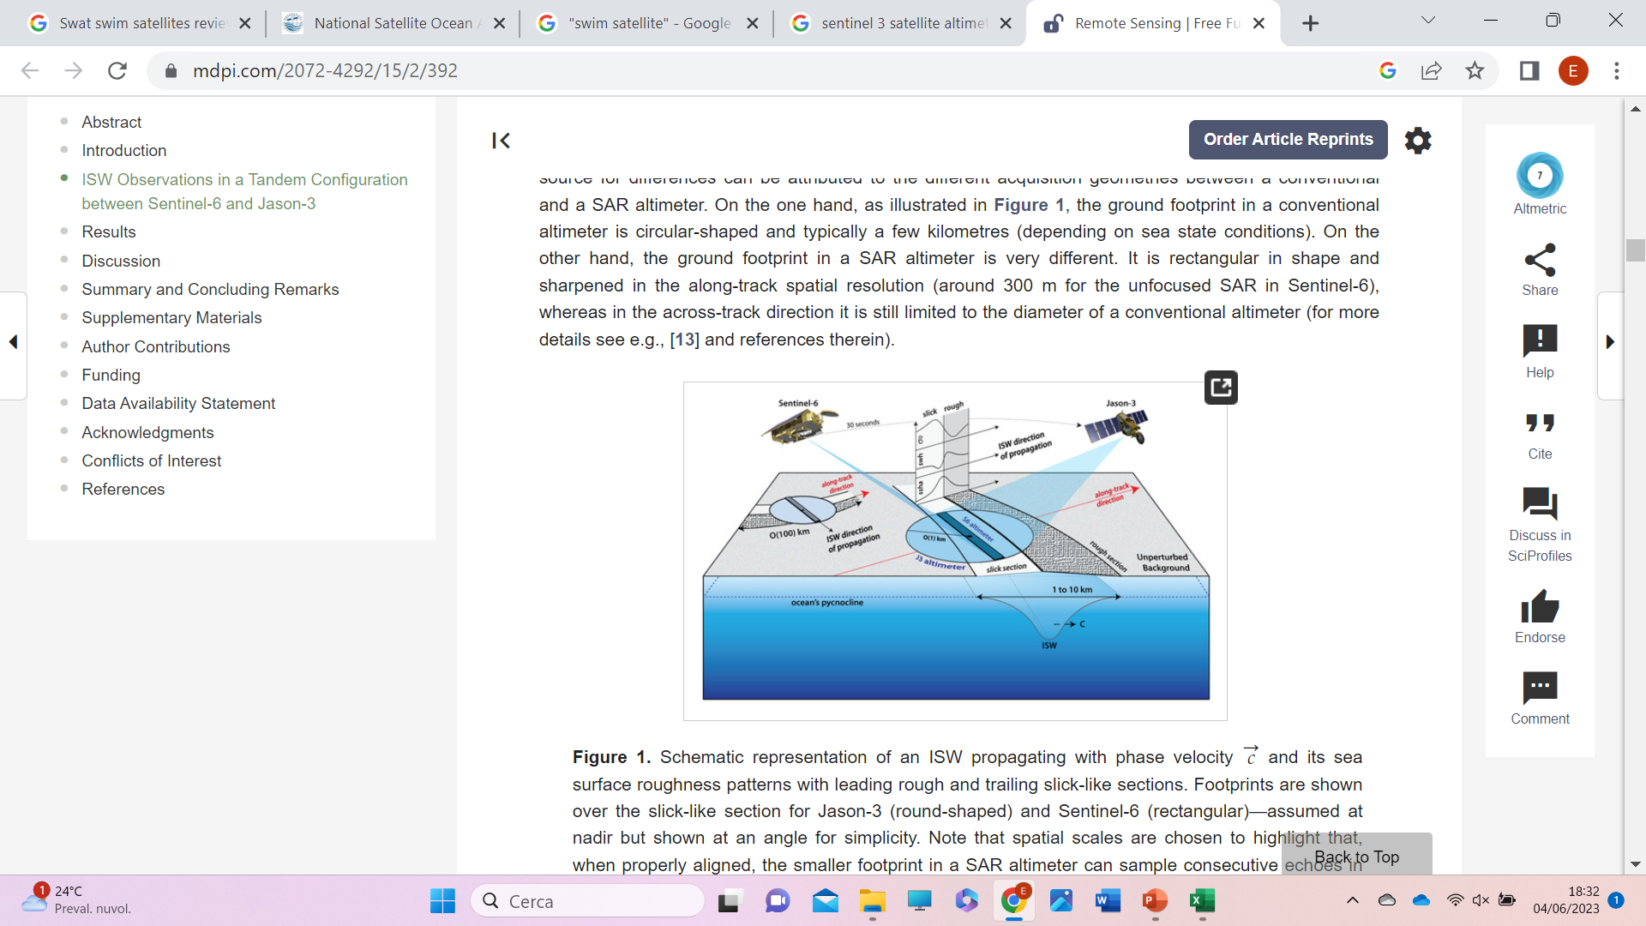
HOW IS WAVE FORECAST CARRIED OUT ?
Assimilation
(Wind, Temperature,
Pressure etc)
Weather Model(s)
(Global and Regional)
Weather
Forecast
METEO (VERY SIMPLIFIED)
wind
Assimilation
(Wave height,
Period, spectrum etc)
Wave Model(s)
(Global, Ocean, Regional)
Wave forecast
Analysis
Re-Analysis
WAVE(SIMPLIFIED)
Wave Archives

Slide 19
WIND – WAVE MODELLING DATA FLOW
A TYPICAL PROCEDURE
Meteo
Wind
assimilation
1
2
3
6
12
24
Previsione 1h
Analysis(6 h)
Wave model
Wave assimilation

Slide 20

Briefly summarizing about satellite altimeters
Indipendent from weather and any kind of
interference.
Extremely reliable (tested over many years) :“the Gold Standard”
( Rossi et al 2022*) of offshore wave measurement.
But
Horrendously expensive (USA, ESA, various space agencies pay for it)
Does not provide spectral information. – Only SWH and wind
* Rossi, G.B.; Cannata, A.; Iengo, A.; Migliaccio, M.; Nardone, G.; Piscopo, V.; Zambianchi, E. Measurement of Sea Waves. Sensors 2022,

Slide 21


