Slide 1
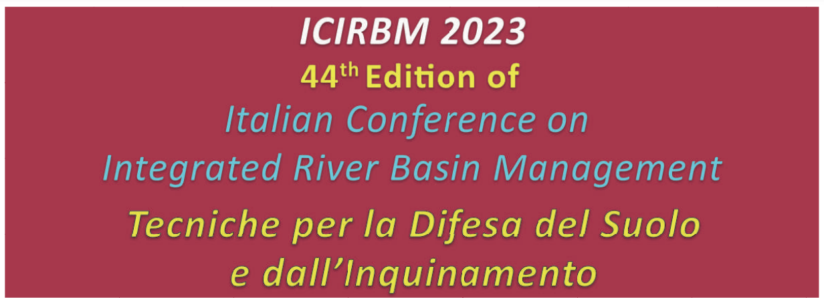

Slide 2
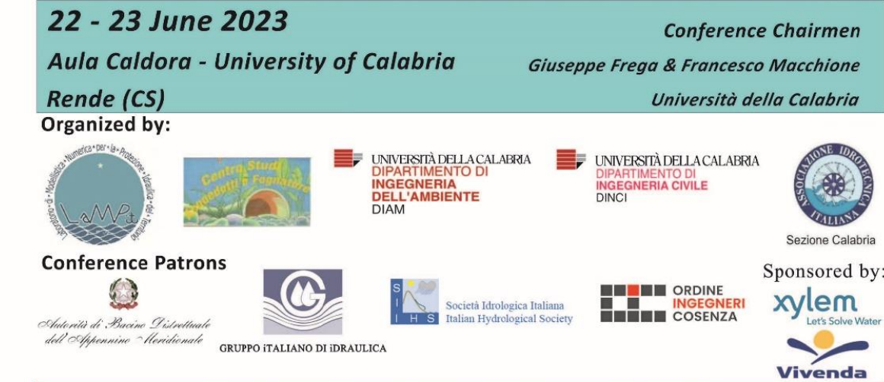
Sea wave measurement by radar systems: basic principles for maritime engineers
Misura delle onde marine con sistemi radar: principi di base perGLI INGEGNERI MARITTIMI
Eugenio Pugliese Carratelli¹, Giovanni Ludeno², Fabio Dentale¹, Angela Di Leo¹
1 MEDUS Department of Civil Engineering, University of Salerno 2 CNR IREA Naples

Slide 3
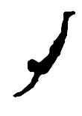
What is it all about?
1) General ideas and a few definitions
2) High incidence angles (grazing) MW: land, ship, platform based systems
3) Low incidence angles MW: satellite altimeter, SAR
4) HF radar
A lot of work has been done, including excellent tutorials on the subject.
Rossi, G.B.; Cannata, A.; Iengo, A.; Migliaccio, M.; Nardone, G.; Piscopo, V.; Zambianchi, E. Measurement of Sea Waves. Sensors 2022, 2
Eugenio Pugliese Carratelli, Giovanni Ludeno, Fabio Dentale, Angela Di Leo. Sea wave measurement by radar systems ICIRBM 2023
Ocean Wind and Wave Measurements Using X-Band Marine Radar: A Comprehensive Review Weimin Huang * ID , Xinlong Liu ID and Eric W. Gill
Some references on the paper

Slide 4

General principles- The incidence angle
_{Angle of incidence α}
E/M wave
ϑ
α
α
Grazing angle. $90−α$
Local Incidence angle ϑ
=α+ local surface slope
Fraction of local backscattered EM energy σ_{l} (ϑ), aka NRCS, «radar section»

Slide 5

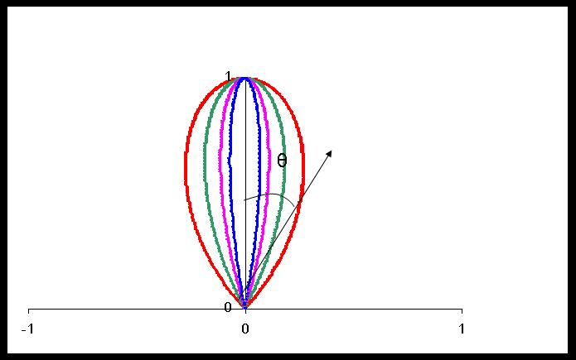
Conceptually, the main factors are:
HH, HV, VV…
Wind influences surface roughness Ko
Local tilt influences σ_{l}
Whitecapping and Ko influence σ_{l}
Orbital Velocity Influences Ko
“Hydrodinamic Modulation”
σl depends
fundamentally on the
incidence angle
_{Rough Surface :scatters}
Smooth Surface: (mostly) reflects
Bragg effect plays a role
For low ϑ- but not in the same way
as in HF (micro, not macro)
Ko f( ϑ)

Slide 6
So σl varies along the surface…
Tilt φ
… and if our resolution is small enough, we see :
Local (“ a few Pixels”) variations («modulation») of σl - connected to wave agitation
Thus we get an image of the wave field

Slide 7
Or else…
If we see an average on “many pixels” σl
We get an average backscattering coefficient σo
Tilt φ
σo
Depends or mainly (not only) on
Roughness & whitecapping
And therefore, basically, on Wind.
(see later: satellite altimetry)

Slide 8

Microwave Systems
vs
High Frequency
Band | Frequency | Wavelength
Ku | 12-18 GHz | 1.67-2.5 cm
X | 8-12 GHz | 3.7-2.5 cm
C | 4-8 GHz | 3.75-7.5 cm
S | 2-4 GHz | 7.5-15 cm
----- | ----- | -----
What is the difference?
Why is it important
Compare
EM and sea wave length
Interacts with
sea waves
Interacts with
foam & ripples
HF 3-30 MHz 10-100 m

Slide 9
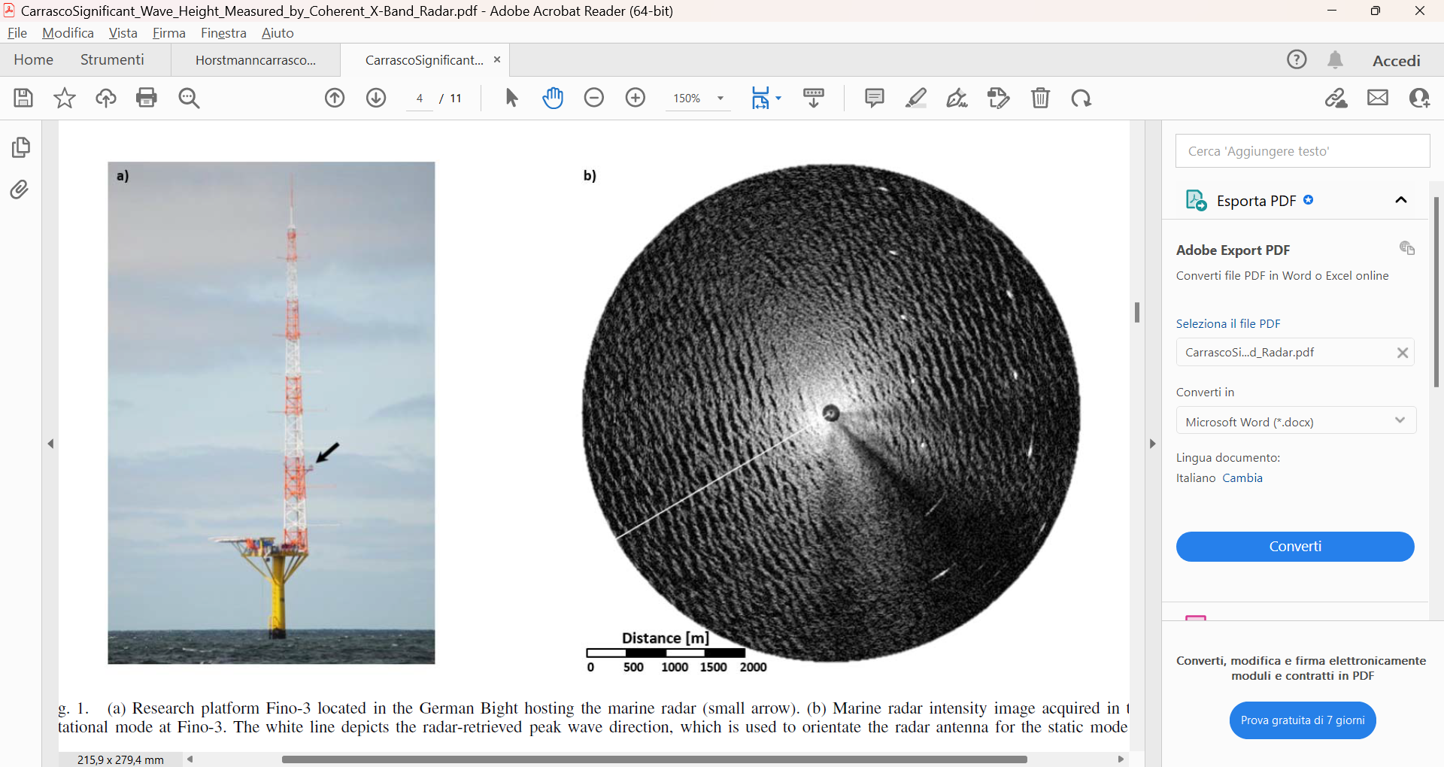
Microwave Systems can be either
Satellite based (Low incidence, near vertical)
or
ship or platform based (Grazing angle)
High Angle of Incidence
(grazing)

Slide 10
As we saw if our resolution is small enough (and it is for MW
we get an image of the wave field
Tilt φ
Local (“ a few Pixels”) variations («modulation») of σl are connected to wave agitation

Slide 11
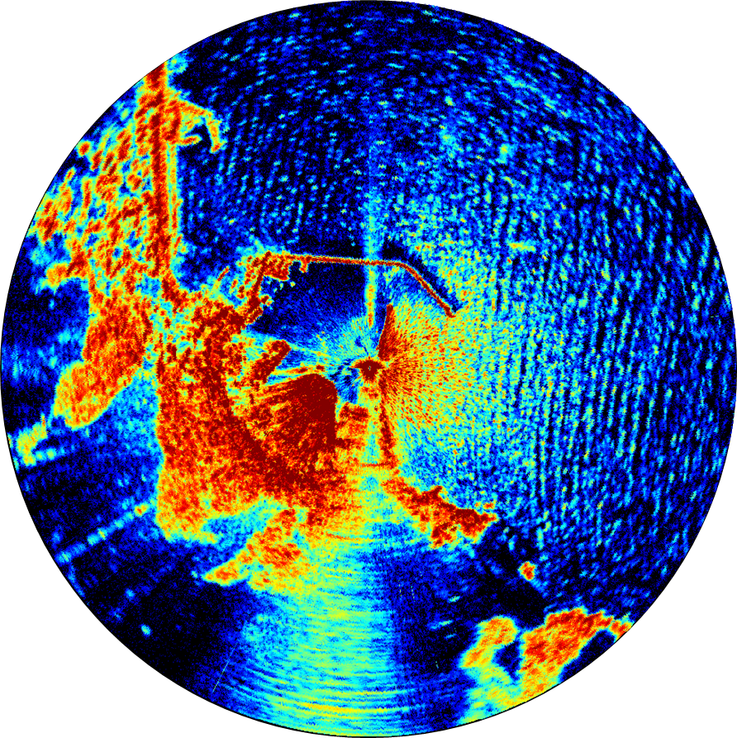

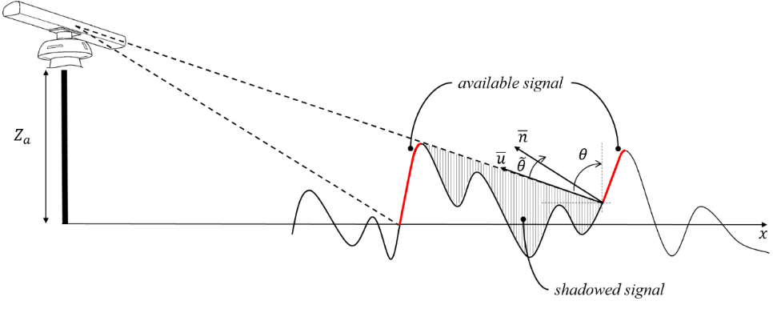
Thus we do get an image, in polar coordinates
Ϭl generates an image I
(in polar coordinates: I(r,ϑ) )
So, apparently
We could easily reconstruct the information we want, i.e. the spectrum (in wavelength and period; SWH)
A typical microwave image of a sea wave field

Slide 12

The instruments of darkness tell us truths,
Win us with honest trifles, to betray 's in deepest consequence.
(Shakespeare, Macbeth)

Slide 13
Unfortunately
The image I(r,ϑ) is indeed related to the sea elevation η(r,ϑ) but it is not the same thing !
As seen earlier on, the backscattered energy I(r,ϑ) depends on various physical phenomena, such as on the slope of the waves and the roughness of the riding ripples, rather than on the water elevation η itself.
The transformation from I(r,ϑ) to η(r,ϑ) is called «modulation»

Slide 14
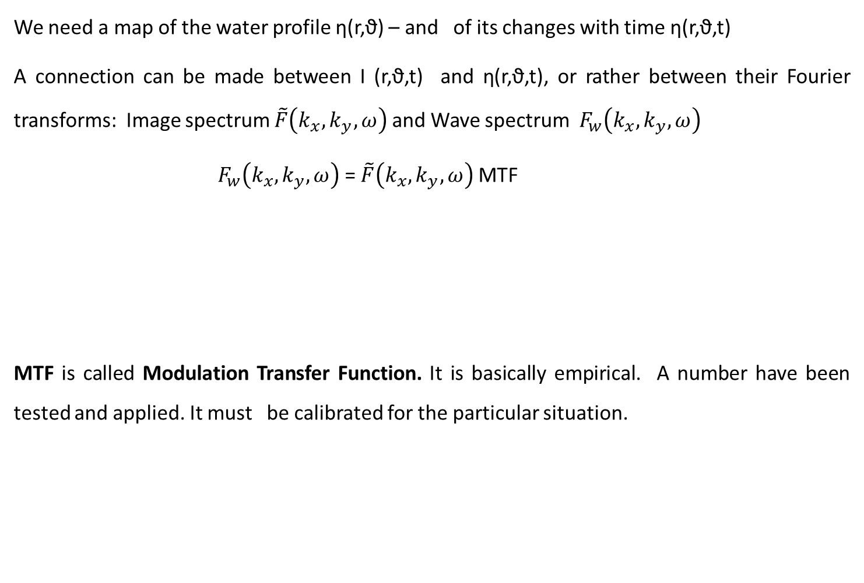
We need a map of the water profile η(r,ϑ) – and of its changes with time η(r,ϑ,t)
A connection can be made between I (r,ϑ,t) and η(r,ϑ,t), or rather between their Fourier transforms: Image spectrum $\tilde{F}\left(k_{x},k_{y},ω\right)$ and Wave spectrum $F_{w}\left(k_{x},k_{y},ω\right)$
${ F}_{w}\left(k_{x},k_{y},ω\right)$ = $\tilde{F}\left(k_{x},k_{y},ω\right)$ MTF
MTF is called Modulation Transfer Function. It is basically empirical. A number have been tested and applied. It must be calibrated for the particular situation.
This assumes that the connection between I and η be linear – and universal too!
the specific location, antenna, height, etc

Slide 15
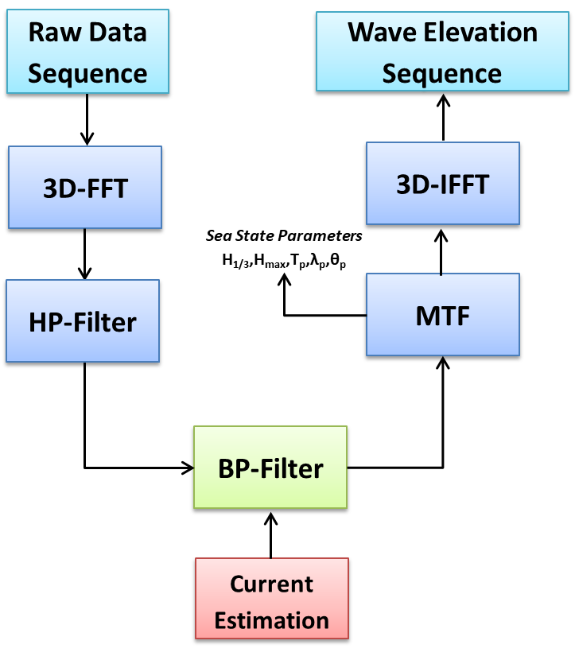
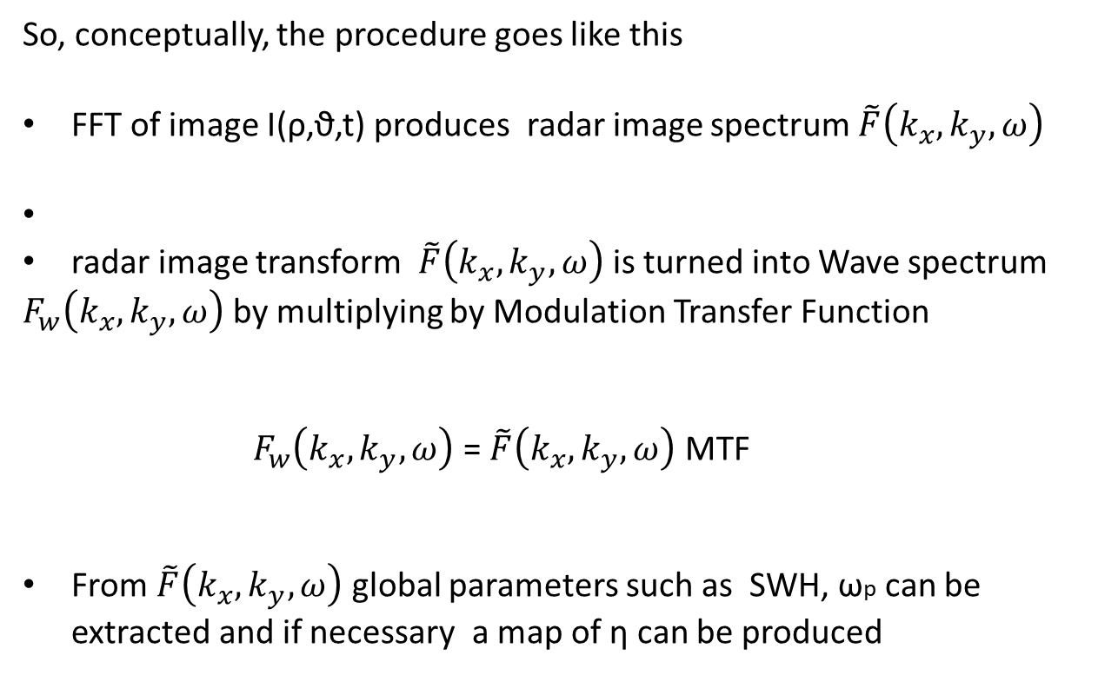
So, conceptually, the procedure goes like this
FFT of image I(ρ,ϑ,t) produces radar image spectrum $\tilde{F}\left(k_{x},k_{y},ω\right)$
radar image transform $\tilde{F}\left(k_{x},k_{y},ω\right)$ is turned into Wave spectrum
$F_{w}\left(k_{x},k_{y},ω\right)$ by multiplying by Modulation Transfer Function
$F_{w}\left(k_{x},k_{y},ω\right)$ = $\tilde{F}\left(k_{x},k_{y},ω\right)$ MTF
From $\tilde{F}\left(k_{x},k_{y},ω\right)$ global parameters such as SWH, ωp can be extracted and if necessary a map of η can be produced
This requires a succession of Images in time I(ρ,ϑ,t) . And this in turn implies a fast enough rotation of the antenna
And yes, this could be done in space coordinates only, with a single Image, but the quality would be very bad indeed
Serafino, Ludeno, et al.
Numerous papers

Slide 16

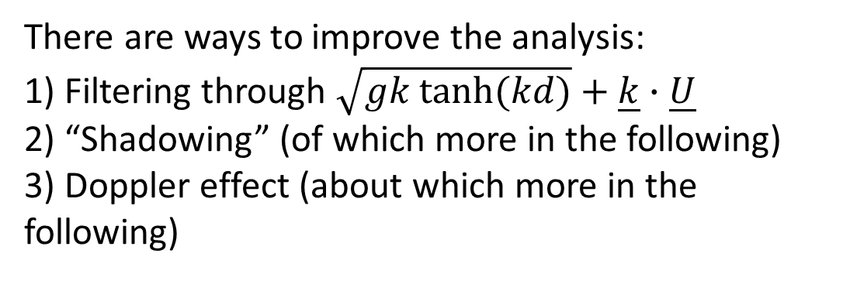
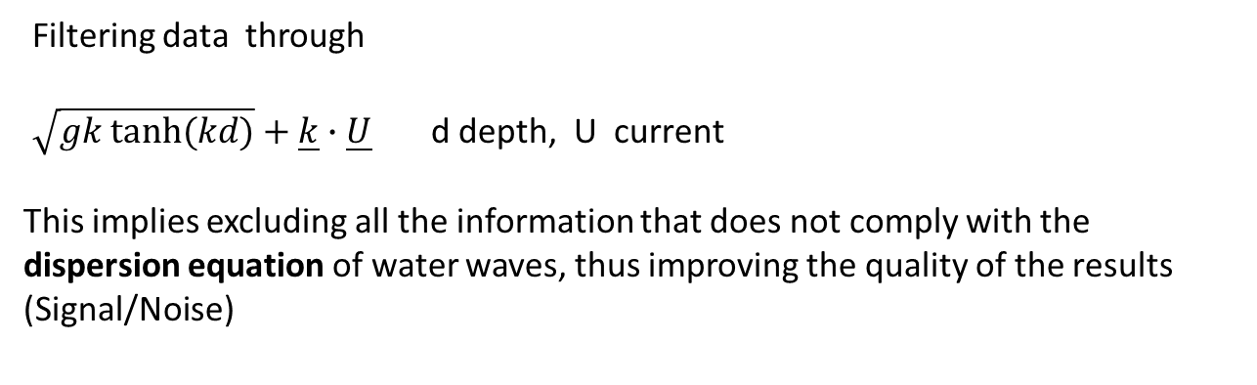
There are ways to improve the analysis:
1) Filtering through $\sqrt{gk tanh⁡(kd)}+\underline{k}∙\underline{U}$
2) “Shadowing” (of which more in the following)
3) Doppler effect (about which more in the following)
Filtering data through
$\sqrt{gk tanh⁡(kd)}+\underline{k}∙\underline{U}$ d depth, U current
This implies excluding all the information that does not comply with the dispersion equation of water waves, thus improving the quality of the results (Signal/Noise)
We basicall tell the algorithm:
we only want hydrodinmically
compatible waves
If U, d are not known, their values can be estimated with an optimization procedure
Ludeno, G., Reale, F., Dentale, F., Carratelli, E.P., Natale, A., Serafino, F. Estimating
Nearshore Bathymetry from X-Band Radar Data (2015) Coastal Ocean Observing Systems,

Slide 17
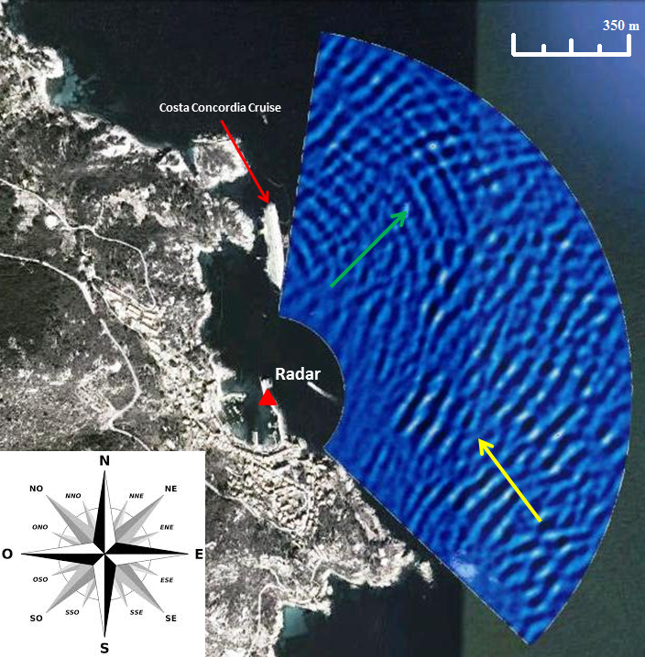
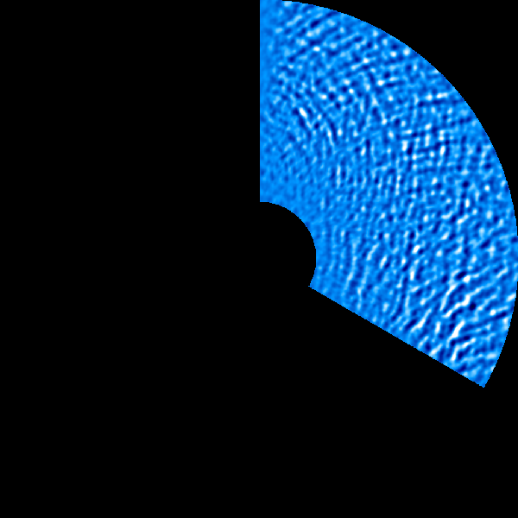
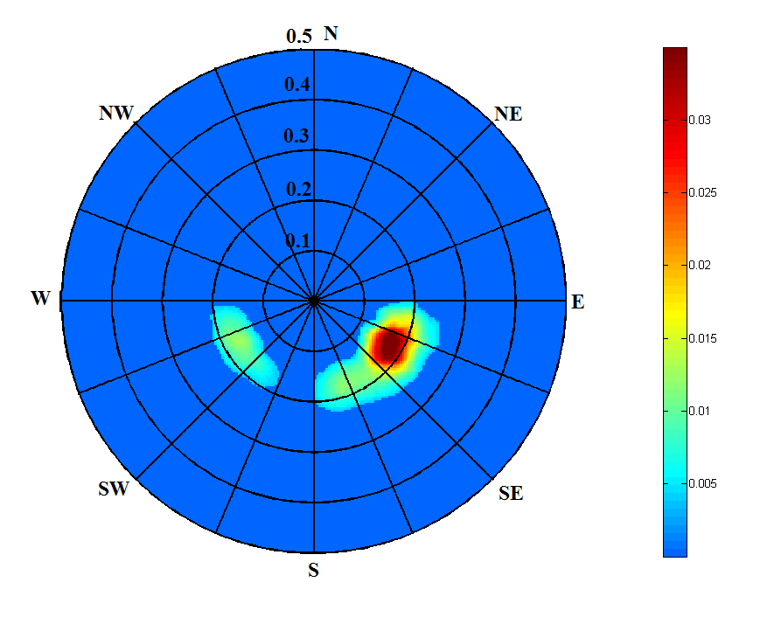
Wave elevation sequence
It works even in complex situations
2D Directional Spectrum retrieved from the wave radar system
Reflected wave
Incident wave
Ludeno, G., Brandini, C., Lugni, C., Arturi, D., Natale, A., Soldovieri, F., ... & Serafino, F. (2014). Remocean system for the detection of the reflected waves from the costa concordia ship wreck. IEEE Journal of Selected Topics in Applied Earth Observations and Remote Sensing, 7(7), 3011-3018.

Slide 18
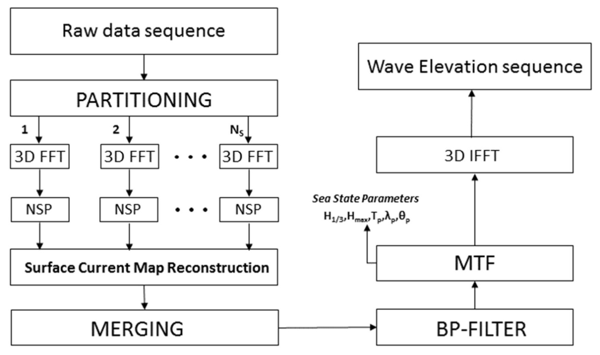
A possible improvement is the partitioning of the radar scene into sub areas,
in order to gather spatial information. Which leads to something like this
(From Ludeno, Serafino et al.)

Slide 19
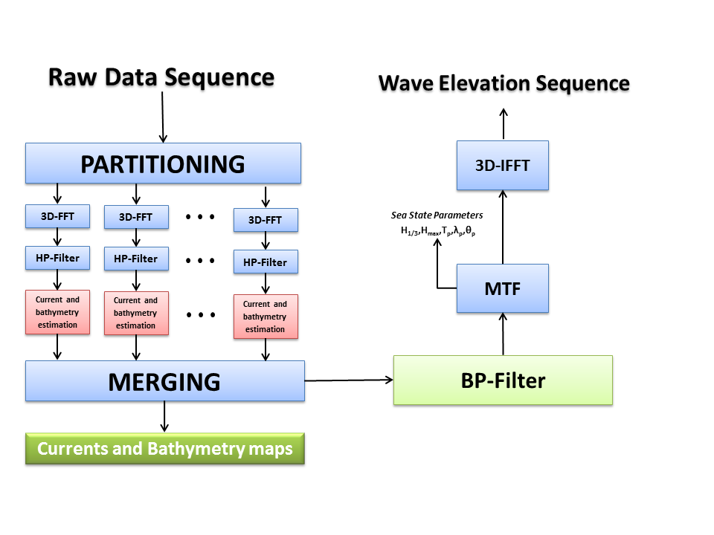
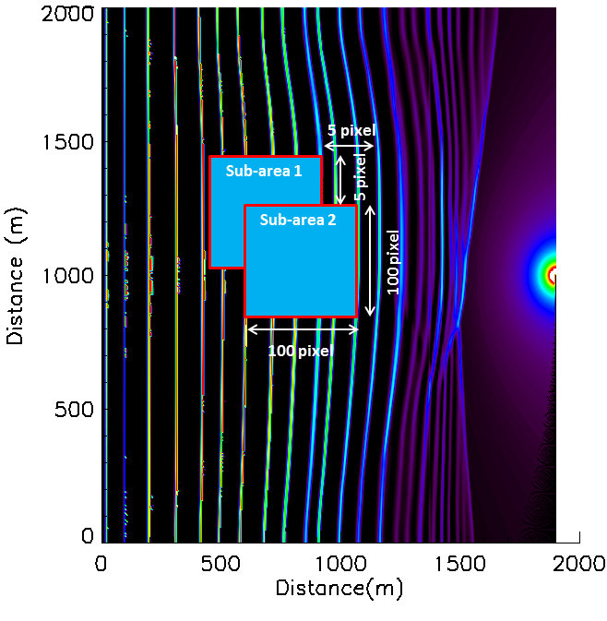
Block diagram of novel data processing approach for the inhomogeneous areas, “Local Method”
The spatial partitioning obtained with partial overlapping of two consecutive sub-area

Slide 20
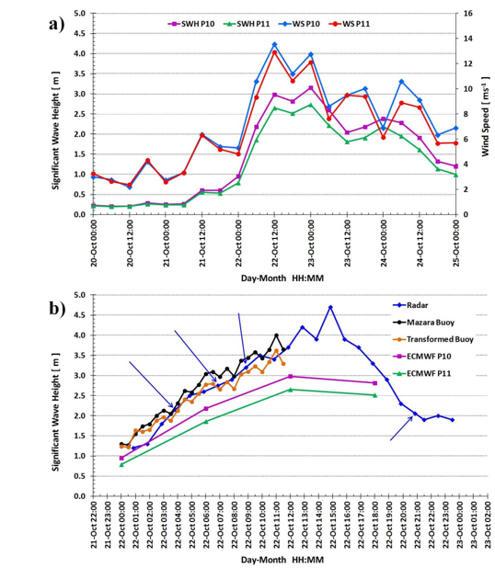
Some real life examples
Plenty of excellent
Empirical/ experimental
results in the literature

Slide 21
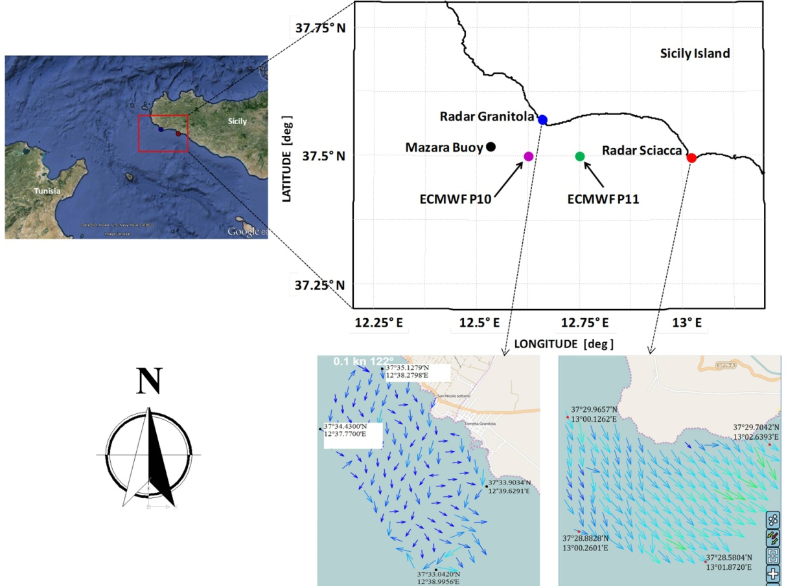
Ludeno, G., Reale, F., Raffa, F., Dentale, F., Soldovieri, F., Carratelli, E.P., Serafino, F. Integration between X-Band Radar and Buoy Sea State Monitoring (2018) Journal of Coastal Research

Slide 22
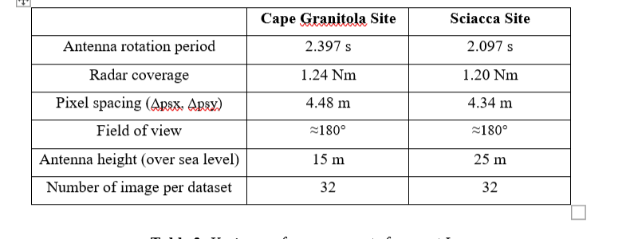
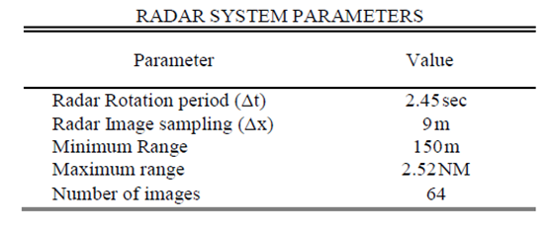
Typical values of the parameters
Antenna rotation period influences accuracy of time FFT
Interval between pulses influences space resolution
Resolution is howvere good enough- Unlike…

Slide 23
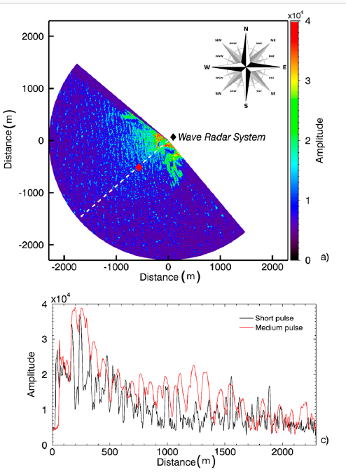
Proof of feasibility of the sea state monitoring from data collected in medium pulse mode by a X-band wave radar system
Ludeno, G., Raffa, F., Soldovieri, F., Serafino, F.
Remote Sensing, 2018,
Pulse length:
To us just a technicality
Pulse duration of about 50 ns) at 9.5 GHz (X-Band) and the pulses are transmitted and received in the horizontal plane (HH polarization).

Slide 24
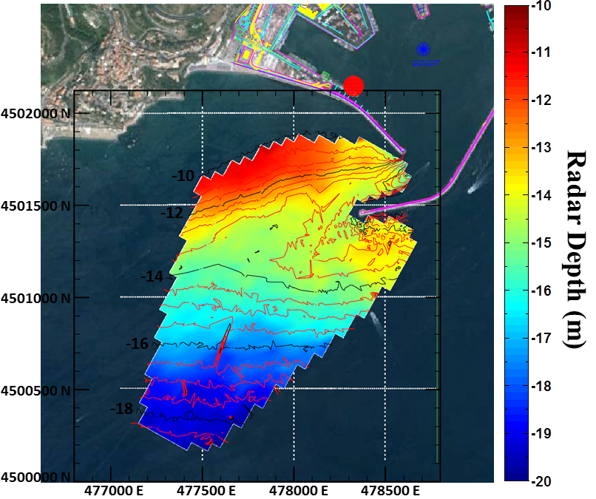
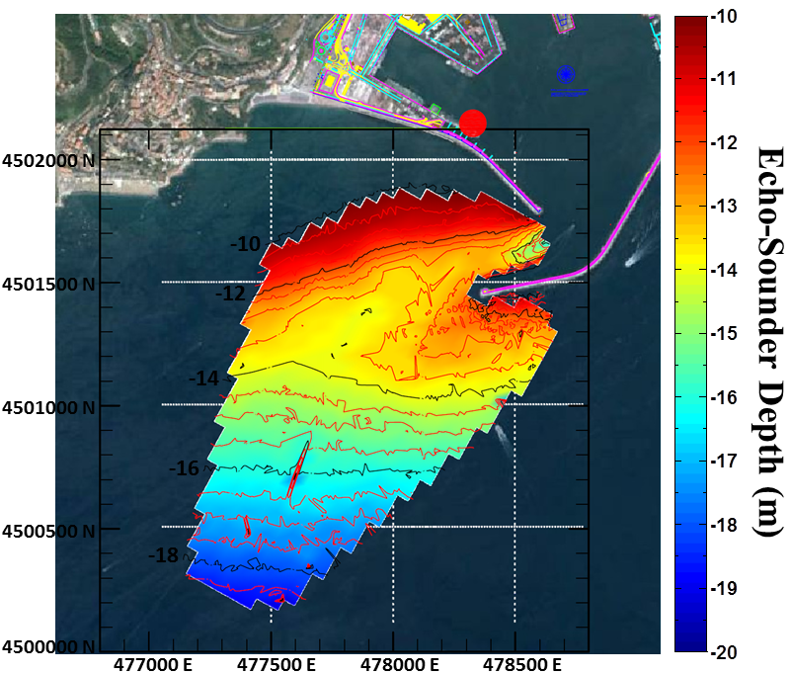
Bathymetry map (Salerno harbour)
Radar Bathymetry
Echo-Sounder Bathymetry

Slide 25
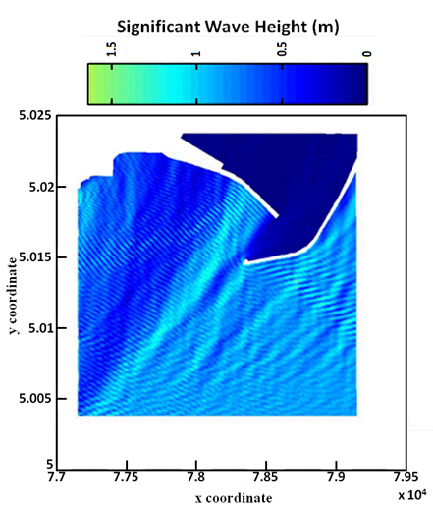
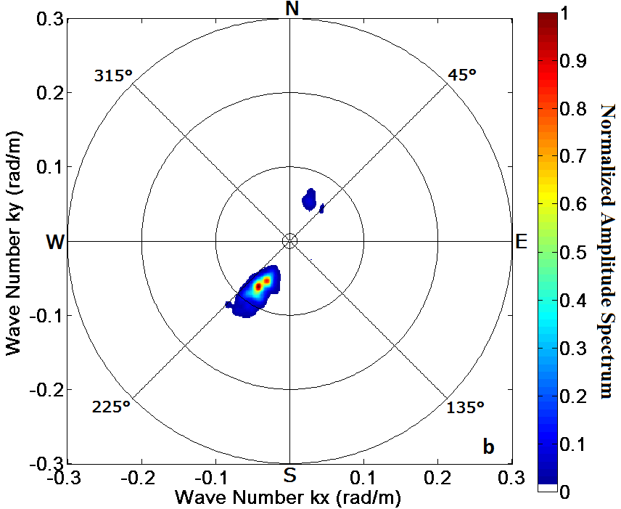
Reflected waves from the jetties
Ludeno, G., Natale, A., Lugni, C., Soldovieri, F., Serafino, F. Remocean: A X-band radar system as tool for environmental monitoring in costa concordia ship wreck management (2014) 7th European Workshop on Structural Health Monitoring, EWSHM 2014 - 2nd European Conference of the Prognostics and Health Management (PHM) Society,

Slide 26

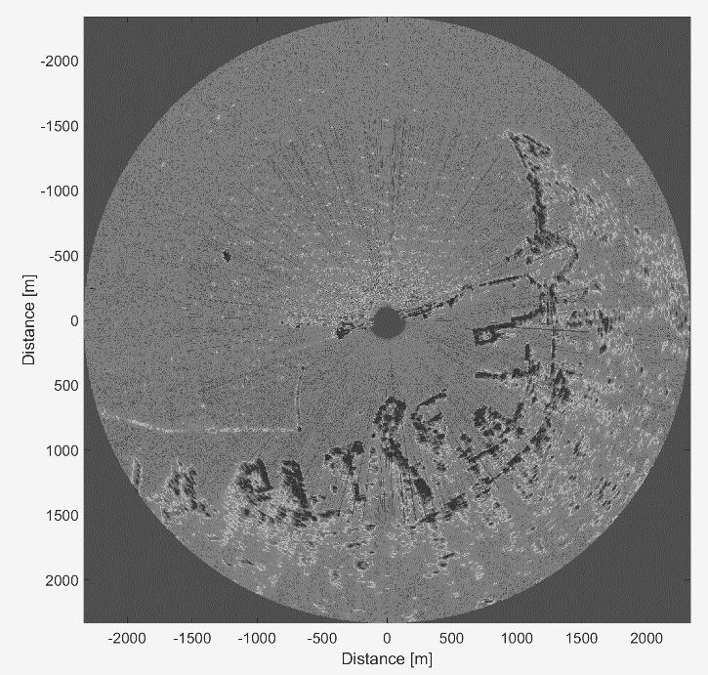
Extracting more information:
Shadowing
The shadowing phenomenon: no reflection from sea spots that are not in the line of sight (Plant and Keller 1990, Lee et al. 1995, Wenzel 1990) can provide a useful tool to extract information from the radar image
Geometrical scheme of the tilt modulation and the shadowing effect. A typical microwave image of a sea wave field (dark and bright areas)

Slide 27
SHADOWING
For a simple monocromatic wave:
More of it later!

Slide 28
Depends on grazing angle
Thus
Antenna height and distance
(so it changes along the radar field)
Has to be computed for each single wave
SHADOWING
On a «real» sea
(onedimensional)

Slide 29
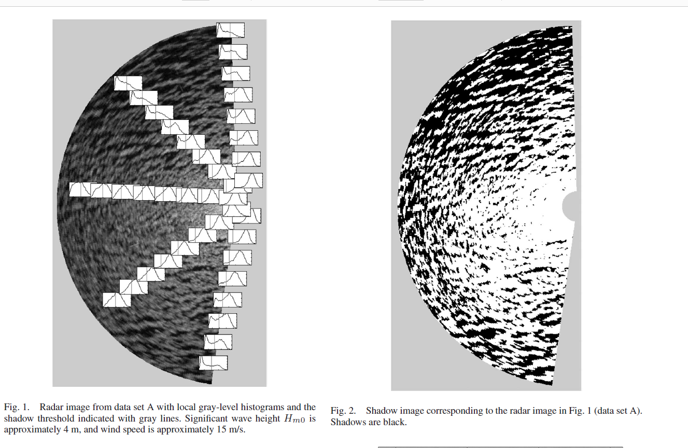
Image
Shadow
Estimating SWH
Shadowing
Real SHADOWING
(2d)
Of course,
The algorithm is complex
but it can be tackled

Slide 30
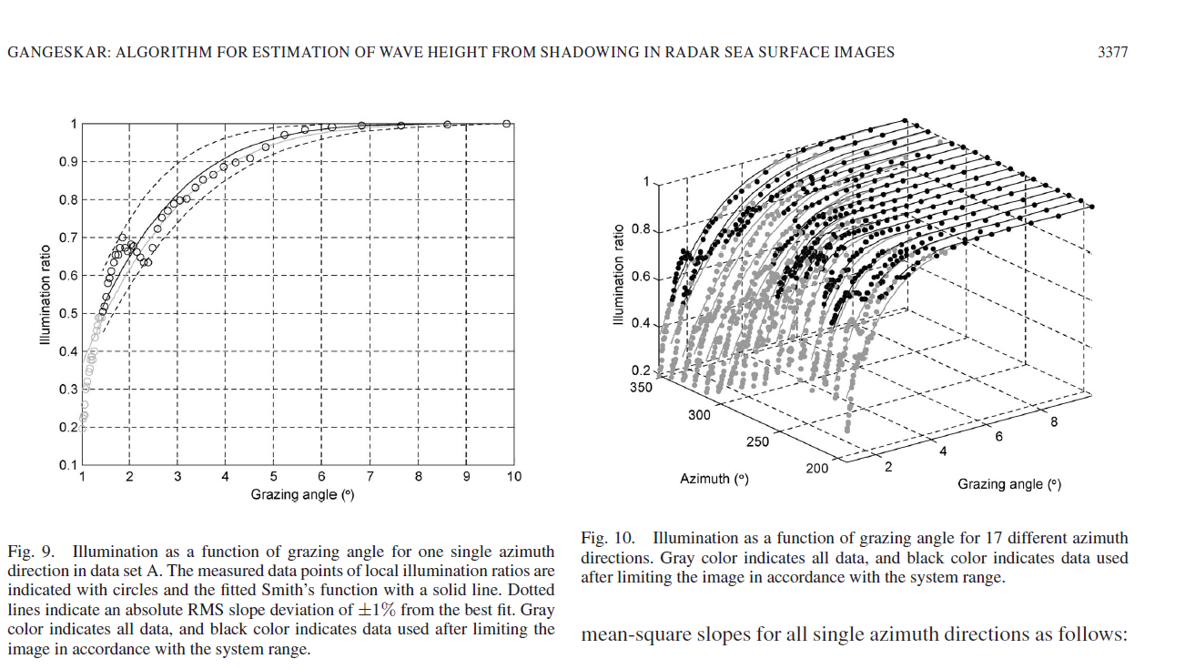
Sea state
For instance: R. Gangeskar (2014)
An Algorithm for Estimation of Wave Height From Shadowing in X-Band Radar Sea Surface Images
IEEE Transactions on Geoscience and Remote Sensing
Doesn’t seem to be fully satisfactory
Possibly, can be integrated
with Spectrum/MTFapproach
Illumination ratio as a function
of grazing angle and look
direction => SWH

Slide 31
Extracting more information:
Doppler, «Coherent»
The most promising trick!

Slide 32
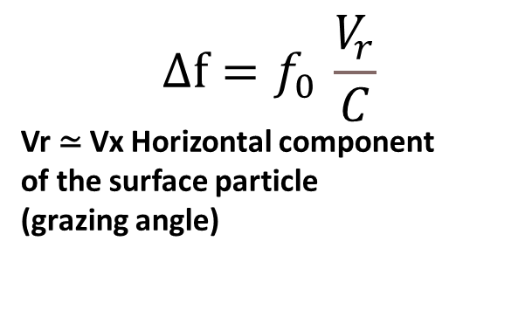
Hwang, P. A., M. A. Sletten, and J. V. Toporkov (2009), A note on Doppler processing of coherent radar backscatter from the water surface: with application to ocean surface wave measurements, J. Geophys. Res., doi:10.1029/2009JC005870 (in press).
The surface orbital velocity of water particles can be exploited to measure the sea state
(Hauser et al. 2005, Chen et al. 2017, 2019, Horstmann 2021
$$∆f=f_{0 }\frac{V_{r}}{C}$$
Vr ≃ Vx Horizontal component
of the surface particle
(grazing angle)
For a simple monocromatic wave:
Incoming wave , fo is
backscattered with a modified
Frequency fo+-Δf
+ if Vr towards the source
- If Vr away from the source
Horizontal component of water particle velocity (Airy theory, drawing not in scale)

Slide 33
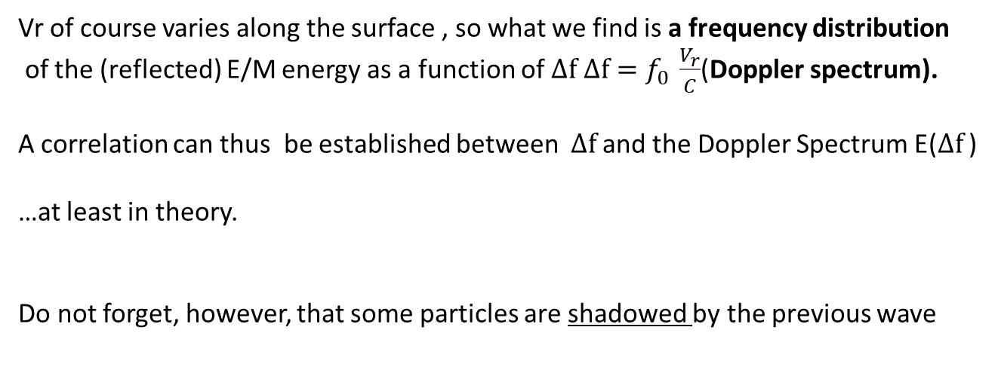
So, if a radar can measure the frequency of the reflected EM waves, it will also measure the Vr
and since Vr ≃ Vx, there is a connection with the wave height H, and with SWH as well
Vz(x,t)=Hωsin(kx-ω t)
Yes, very much
Like in HF system.
Less messy, though,
since Bragg is not
Interfering
So, you don’t get
«first» and «second»
order spectra
Vr of course varies along the surface , so what we find is a frequency distribution
of the (reflected) E/M energy as a function of $∆f$ $∆f=f_{0 }\frac{V_{r}}{C}$(Doppler spectrum).
A correlation can thus be established between $∆f$ and the Doppler Spectrum E($∆f$ )
…at least in theory.
Do not forget, however, that some particles are shadowed by the previous wave

Slide 34
SHADOWING
Plays a role here, too
Shadowing changes according to antenna elevation/distance
And wave spectrum

Slide 35
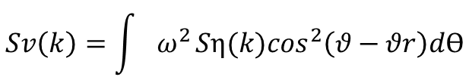
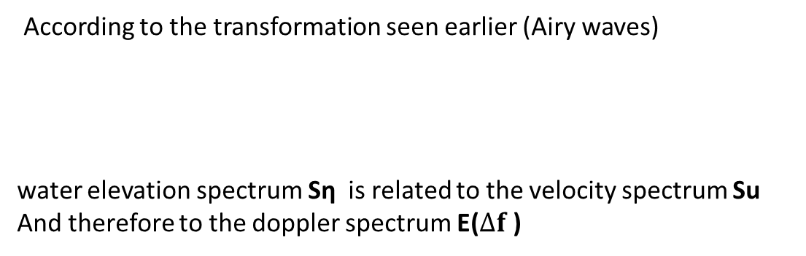
For a real non-monochromatic sea, the problem is complicated-
But it can still be managed
According to the transformation seen earlier (Airy waves)
water elevation spectrum Sη is related to the velocity spectrum Su
And therefore to the doppler spectrum E($∆f$ )
Vz(x,t)=Hωsin(kx-ω t)
Toporkov and G. S. Brown, "A numerical study of backscattering from time-evolving sea surfaces: comparison of hydrodynamic els," in IEEE Transactions on Geoscience and Remote Sensing, vol. 39 2001, doi: 10.1109/36.964977.
$$Sv\left(k\right)=\int{ω^{2}}{Sη(k)cos}^{2}\left(θ−θr\right)dϴ$$
$∆f=\text{fo}\frac{V_{r}}{C} so Sv(k)\text{\sim }\text{E}(∆f$ )

Slide 36

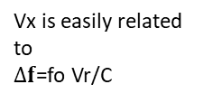
Note asimmetry
Depends on shadowing
(and direction of waves
Simulated!
Histogram of Vx occurences
If you introduce
Shadowing effect
Histogram of Vx=Vr occurences
taking shadowing into account
DEP.1 .2 .3 etc: degree of shadowing
Vx=~Vr , grazing angle
Vx is easily related to
$∆f$=fo Vr/C

Slide 37
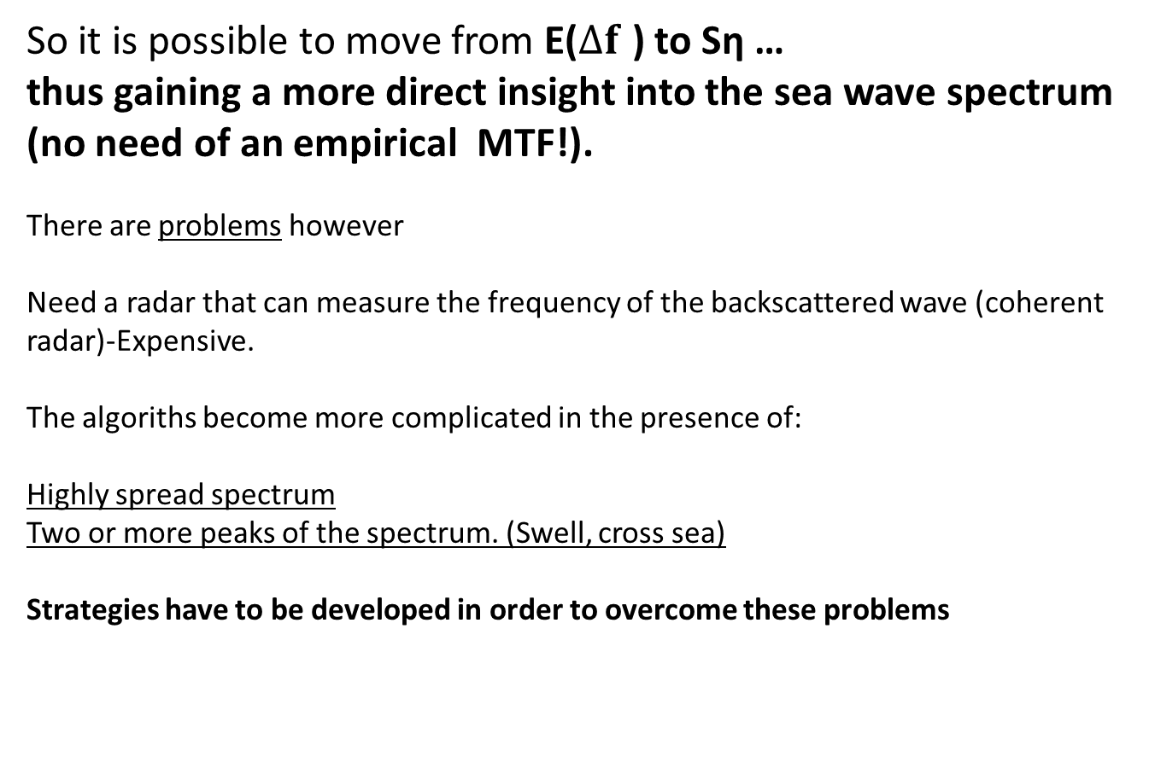
So it is possible to move from E($∆f$ ) to Sη …
thus gaining a more direct insight into the sea wave spectrum (no need of an empirical MTF!).
There are problems however
Need a radar that can measure the frequency of the backscattered wave (coherent radar)-Expensive.
The algoriths become more complicated in the presence of:
Highly spread spectrum
Two or more peaks of the spectrum. (Swell, cross sea)
Strategies have to be developed in order to overcome these problems

Slide 38
A possible way- Carrasco et al
Locate direction on image- then Doppler on the peak direction
Ruben Carrasco, Jochen Horstmann, and Jörg Seemann Significant Wave Height Measured by
Coherent X-Band Radar IEEE TRANSACTIONS ON GEOSCIENCE AND REMOTE SENSING, VOL. 55, NO. 9, 2017
Retrieve spectrum peak direction (Non Doppler mode )
Orient the antenna into the radar-retrieved peak wave direction
(looking up-wave) to acquire the Doppler spectrum
To obtain stable Doppler velocities, the radar has to observe the same points over a relatively long time period. This is achieved by pointing the radar antenna into the peak wave direction, which will only allow to measure the orbital velocity component in the radar look direction. Then, the directional wave spectrum is retrieved from the radar data acquired with rotating antenna
In detail:
hourly cycle starting with 10 min of rotational data, which were utilized to retrieve the wave spectra and in particular the peak wave direction [3].
After these acquisitions the antenna is oriented into the radar-retrieved peak wave direction (looking up-wave) to acquire the Doppler spectrum (“static measurement”)
pulse repetition 1 kHz, allowed to ± maximum radial Doppler speed of 8 m/s
pulselength of 50 ns,thus a range resolution of 7.5 m.
antenna a vertical beam opening of 21° and a width of 7.5 feet (2.3 m) resulting in an azimuthal resolution of about 1°

Slide 39
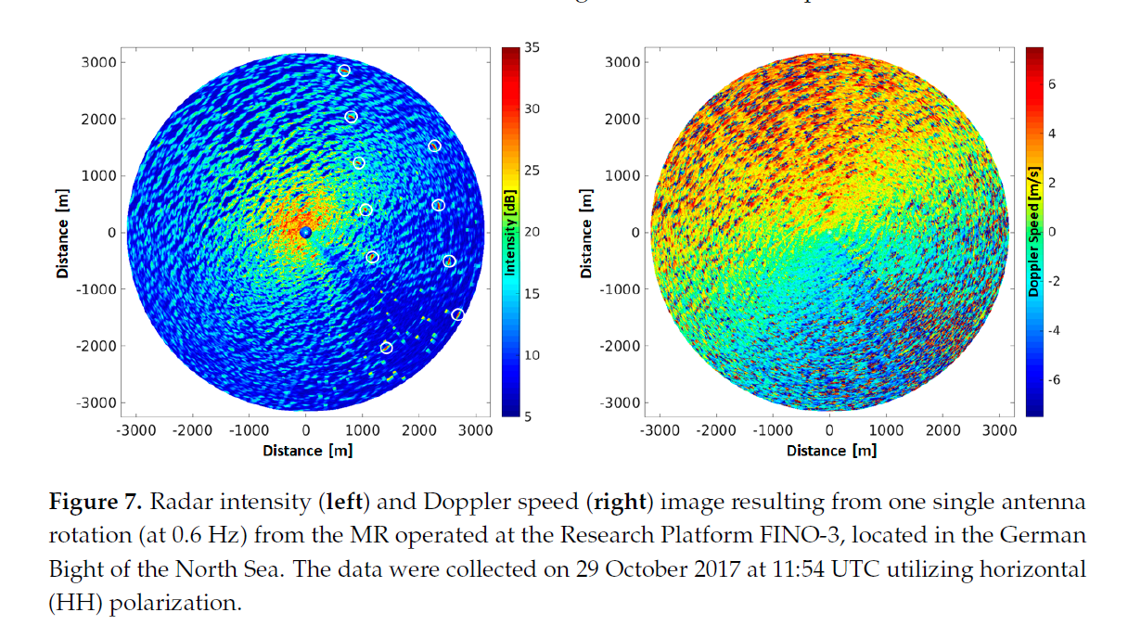
Carrasco et al 2017

Slide 40
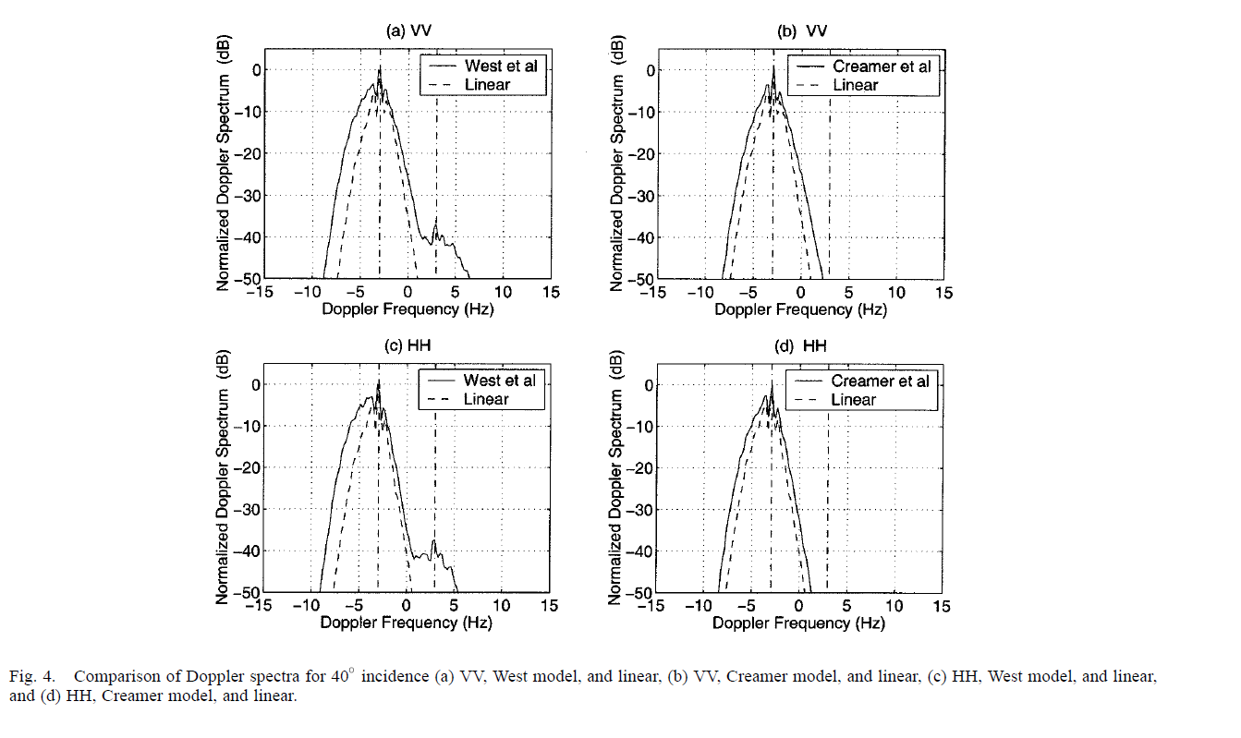
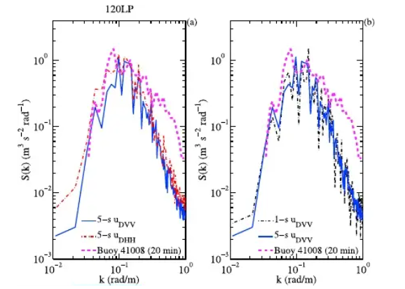

Note:
asimmetry
Difference from
Linear model
Paul A. Hwang,1 Mark A. Sletten,1 and Jakov V. Toporkov1 A note on Doppler processing of coherent radar backscatter from the water surface: With application to ocean surface wave measurements
J. T. Johnson, J. V. Toporkov and G. S. Brown, "A numerical study of backscattering from time-evolving sea surfaces: comparison of hydrodynamic models," in IEEE Transactions on Geoscience and Remote Sensing, vol. 39, no. 11, pp. 2411-2420, Nov. 2001, doi: 10.1109/36.964977.
By the way, we did not mention the
polarization issue:HH,VV, HV..
Maybe later.

Slide 41

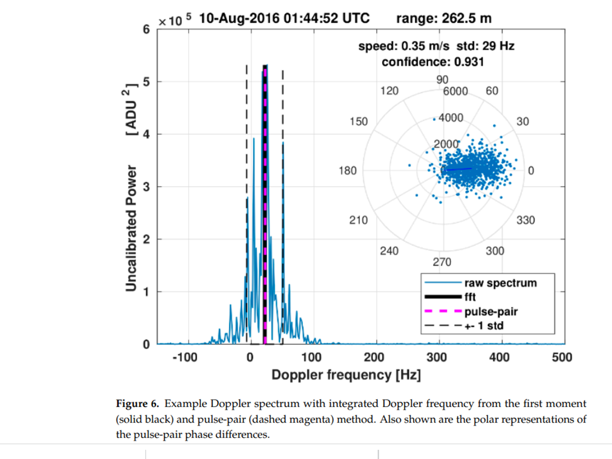
Horstmann, J., Bödewadt, J., Carrasco, R., Cysewski, M., Seemann, J., & Streβer, M. (2021). A coherent on receive x-band marine radar for ocean observations. Sensors, 21(23) doi:10.3390/s21237828
9.4 GHz pulse length 50 ns pulse rep freq up to 2000
Rotatio 1- 2 rps ris ang .012 range res 7.5 m altezza 43 m
VV «much better»
Note asymmetry
Data processing on the received
signal provides Doppler information
With a non- coherent radar

Slide 42
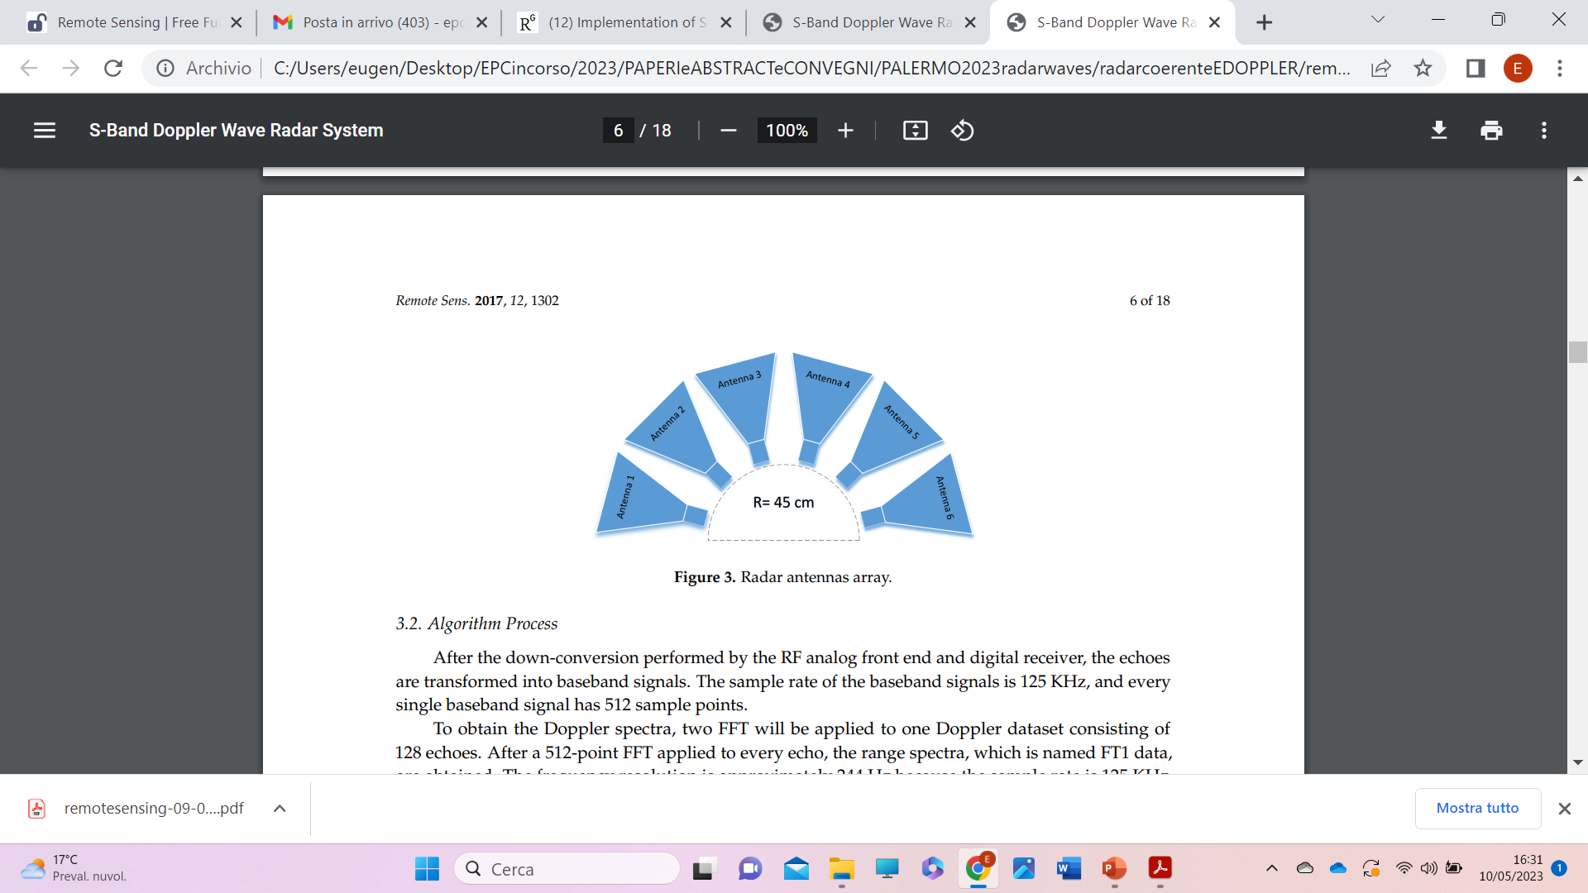
Another possible way:many antennas
Chen et al-
Chen Z., Wang Z., Chen X., Zhao C., Xie F., He C. (2017). S-Band Doppler Wave Radar System. Remote Sensing 9, 1302
MORSE
six horn antennas with each beam width of 30
FMICW(Frequency Modulated Interrupted ContinuousWave) operating frequency of MORSE ranges from 2.75 GHz to 2.95 GHz about 10 cm wavelength. (S Band )
FMICW(Frequency Modulated Interrupted ContinuousWave) operating frequency ranges from 2.75 GHz to 2.95 GHz about 10 cm wavelength. (S Band )
Range 0.01–0.5 Hz, 0–360
Resolution (freq) 0.01 dir Hz/10°
Update Time 2.5 min
Range Resolution 5/7.5/15 m Variable
Detecting Range 5 km
Polarization VV Wavelength 10.5 cm

Slide 43
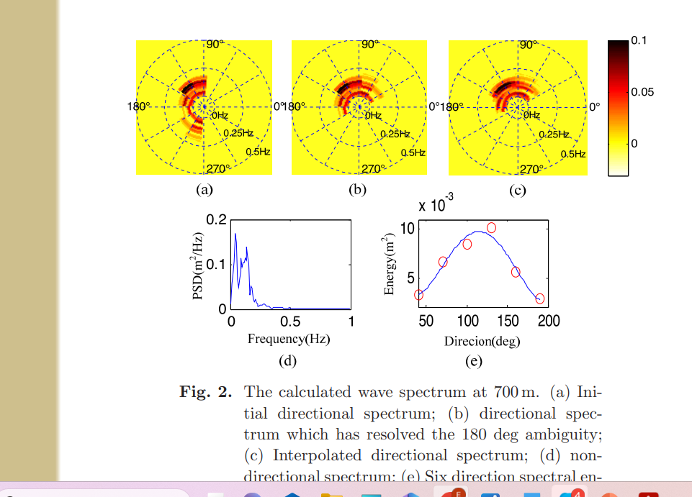
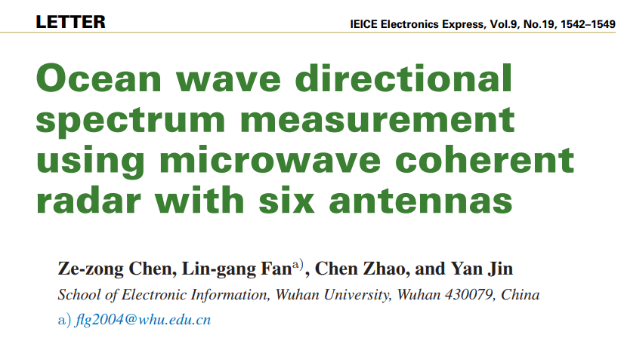

Slide 44
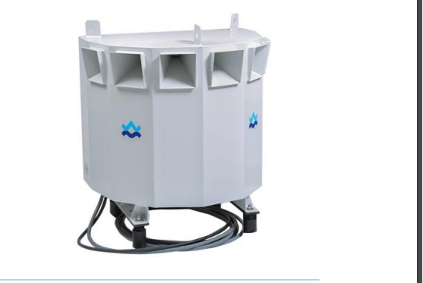

Only commercially available Doppler wave radar
MIROS, C band (5.8 MHz)
No information available
daHauser et al2005

Slide 45
On a different tack
(Ludeno et al. 2023, J. Cui et al. 2019).
«Small is beautiful»
Very short wavelength, very short range
K-band (SRK) radars with a frequency band 18-27 GHz ( wl 0.016-0.01) are being experimented for sea state monitoring. These systems have small coverage range (e.g. 100-300 m), but high temporal and spatial resolution, small size, and low weight. They are thus useful to analyse sea waves near the coast or in semi-closed areas (e.g. bays, harbours).
Emitted power | +18 dBm
Elevation beamwidth | 12.8°
Azimuth beamwidth | +/- 75°
Maximum range | 300m
Range resolution | 0.6m
Azimuth resolution | 7° (@0°) 13°(@75°)
Alimentazione | USB
Size | 13 x 11 (cm)
Weight (radar + case) | 410 g
radome/case | waterproof
Remember: short wl
Better resolution
Lower range
Affected by rain
Ludeno, G., Catapano, I., Soldovieri, F., Gennarelli, G. Retrieval of Sea Surface Currents and Directional Wave Spectra by 24 GHz FMCW MIMO Radar (2023) IEEE Transactions on Geoscience and Remote Sensing, 61, art. no. 5100713, .

Slide 46
Ludeno, G., Catapano, I., Soldovieri, F., Gennarelli, G. Retrieval of Sea Surface Currents and Directional Wave Spectra by 24 GHz FMCW MIMO Radar (2023) IEEE Transactions on Geoscience and Remote Sensing, 61, art. no. 5100713, .
The antennas have horizontal and vertical beam widths of 30 degrees and 25 degrees, and each of them covers an angle of 30 degrees. A single antenna requires 3 min to collecting data; therefore, the total time required for a full directional wave height spectrum is 18 min.
Preliminary result show a significant accuracy in the measurement of SWH. However, the results of the average wave period, especially for a low sea state, are not satisfying. Yet.
Doppler is being considered

Slide 47
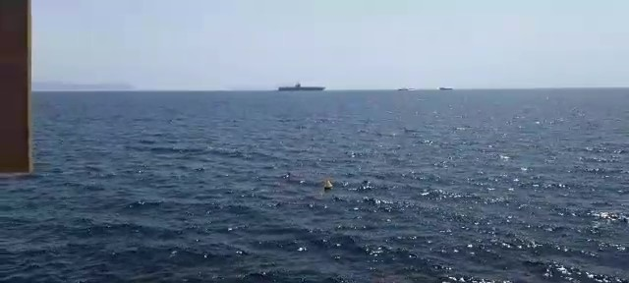
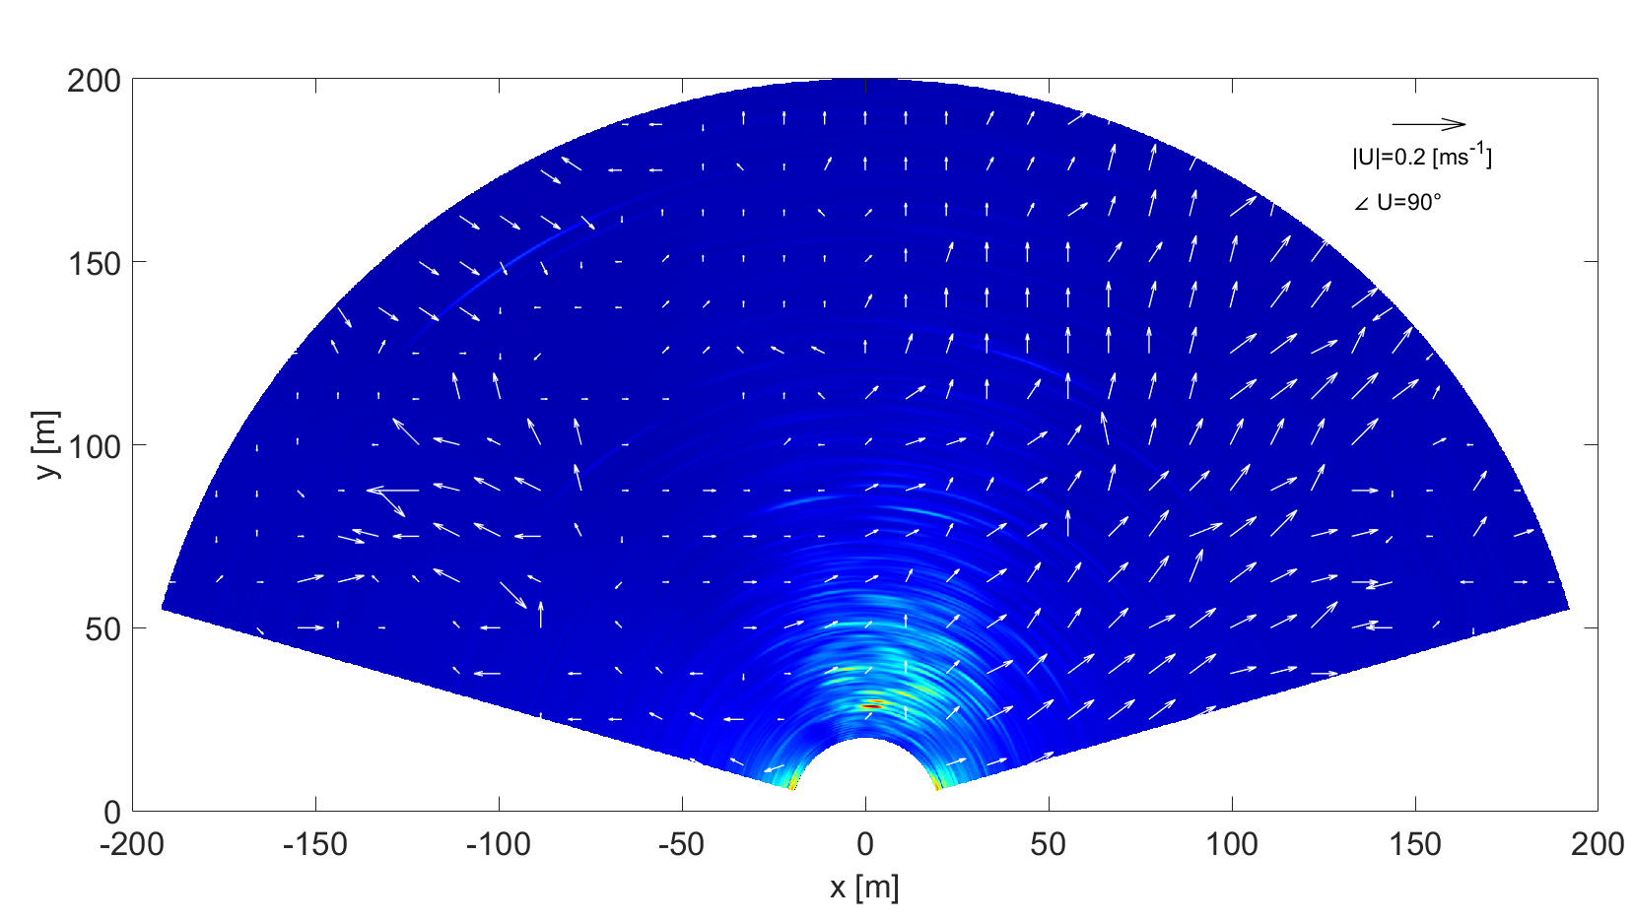
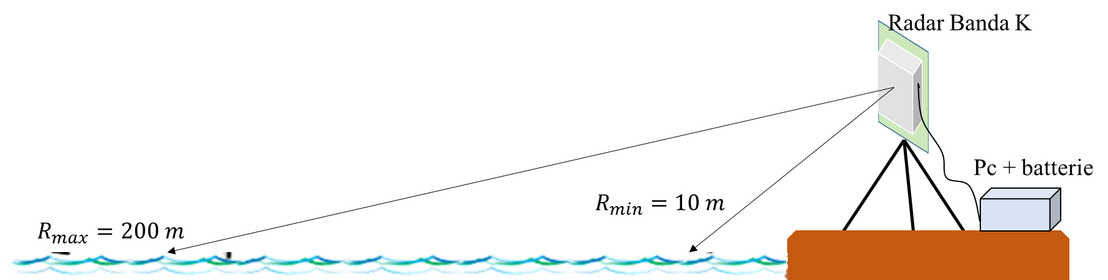
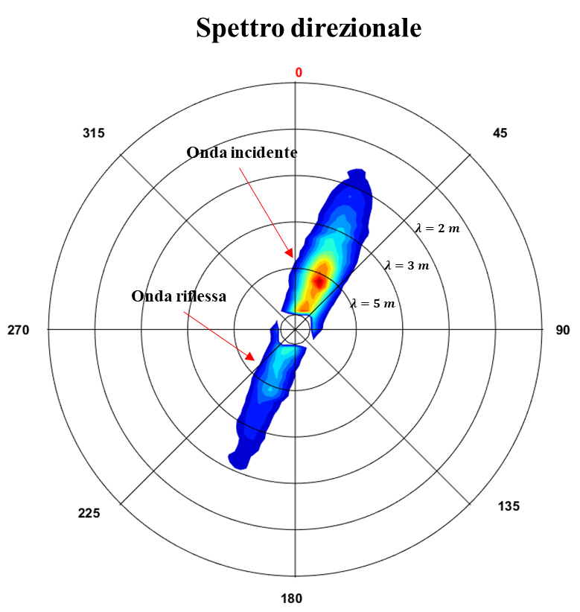
Low sea state at molo San Vincezo (Napoli)
«Small is beautiful»
Very short wavelength, very short range
Sea surface current map
Ludeno, G., et al Retrieval of Sea Surface Currents and Directional Wave Spectra by 24 GHz FMCW MIMO Radar (2023) IEEE Transactions on Geoscience and Remote Sensing, 61, art. no. 5100713
Directional spectra:
$θ=26°$ $λ=5.7 m$

Slide 48
Briefly summarizing about MW wave radar
Reasonably low cost
Good reliabiliy once properly calibrated and tested
But
Sensitive to rain/hail (X Band)
New promising development (Doppler)

Slide 49


